Slide 1
Measurement Decision Risk
Measurement uncertainty and conformity assessment
Primary Standards Lab
SAND2022-5860 TR

Slide 2
Class Agenda
Decision making and conformity assessment
Specific and global risk
Determining prior information
Simplified risk metrics
Risk management and guardbanding
When TUR doesn’t work

Slide 3
Introductions
Introduce yourself
Name
Organization
Background (EE, ME, Quality, etc.)
Type of measurement (calibration, product inspection, etc.)

Slide 4
Learning Objectives
Define “measurement decision” and how uncertainty in a measurement leads to risk in the decision
Calculate test uncertainty ratios given tolerance limits and measurement uncertainty
Understand the limitations and assumptions of the test uncertainty ratio and 4:1 metric
Understand the difference between specific and global risk and the formulas used to compute them
Use Sandia’s uncertainty calculator to calculate specific and global risk for various measurement cases
Calculate guardband acceptance limits based on TUR or targeted risk levels
Understand risk in one-sided limits
Select appropriate acceptance limits and decision rules based on the available information for a measurement

Slide 5
Prerequisites
Basic understanding of Measurement Uncertainty Evaluation
Familiarity with Probability Density Functions and Calculus (i.e. double integrals)
Q1. What quantity are you measuring? |  |  | Q2: How accurate do the measurements need to be? |  |  | Q3: How will you ensure your equipment can make this measurement?
Quantity Measured | MC | Requirement Number | Value or Range of Values Measured | Tolerance Limits | Guardbanded Acceptance Limit | Equipment Used (M&TE) | Measurement Uncertainty | TUR (>4 desired) | Calibrate (Yes/No)
This class: what does TUR and guardband really mean about a measurement?

Slide 6
Reference Materials
JCGM 106:2012. Evaluation of measurement data – The role of measurement uncertainty in conformity assessment. https://www.bipm.org/en/publications/guides
S. Crowder, C. Delker, E. Forrest, N. Martin. Introduction to Statistics in Metrology. Springer, 2020. (esp. Chapter 5)
This class follows notation in JCGM 106. Literature on risk evaluation is very inconsistent and often leads to confusion. See Appendix slides for translation of conventions to other authors’ work.

Slide 7
Section 1 Measurement Decisions and Conformity Assessment

Slide 8
Section 1 – Measurement Decisions and Conformity Assessment
Objective
Define “measurement decision” and “conformity assessment” and describe how uncertainty in measurement leads to risk in the decision outcome
Content
Risk assessment
Types of measurement decisions
Conformity assessment
Risk in decision outcome
Standards and Requirements

Slide 9
Examples of decisions based on measurement
Calibration: Is the power supply operating within tolerance?
Manufacturing: Does the widget meet its engineering specifications?
R&D: Should the grant proposal be funded based on initial data?
Application: Should the aircraft take off based on measured air speed?
Commerce: How much should you pay for that tank of gasoline?
Entertainment: Can we use this football in the Super Bowl?
All measurements have uncertainty, so all decisions have risk of being incorrect!

Slide 10
What is risk? (Quality engineer’s definition)
Risk describes how uncertain events may cause loss to a particular individual or group
Complete identification of risk requires definition of:
Undesirable Events
Likelihood or uncertainty of undesirable events
Consequences of undesirable events, quantification of loss

Slide 11
What is risk? (Quality engineer’s definition)
Risk describes how uncertain events may cause loss to a particular individual or group.
Identification of: Undesirable events, probability of those events, and quantification of cost of those events
Overall Risk = (Probability of an undesirable outcome) × (Consequences of the undesirable outcome)
Likelihood Tier | Consequence Tier
 | Catastrophic | Severe | Moderate | Low | Negligible
Very High | VH | VH | H | M | L
High | VH | H | M | M | L
Moderate | H | M | M | L | L
Low | M | M | L | L | N
Negligible | L | L | L | N | N
See SNL Policy QA001.2 for general guidance on evaluating consequence and likelihood levels.

Slide 12
Definition: Conformity Assessment
Conformity Assessment is any activity undertaken to determine, directly or indirectly, whether a product, process, system, person, or body meets relevant standards and fulfills specified requirements.
– JCGM 106

Slide 13
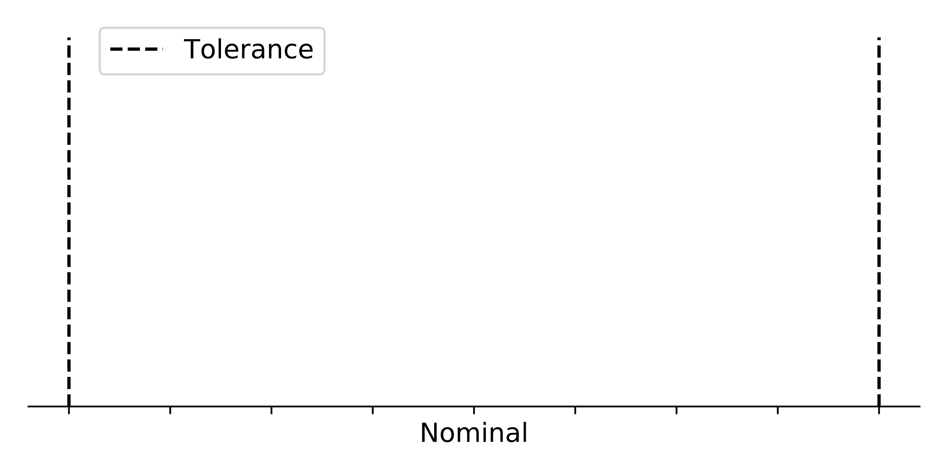
Measurement Decision
To meet requirements, a measurement must be between the dashed lines
Calibration limits
Engineering specification on manufactured components
Airspeed required for safe takeoff
Etc.
Notes:
Note the slight difference in interpretation when discussing conformity in a calibration lab vs conformity in product acceptance. The math and concepts are the same.

Slide 14
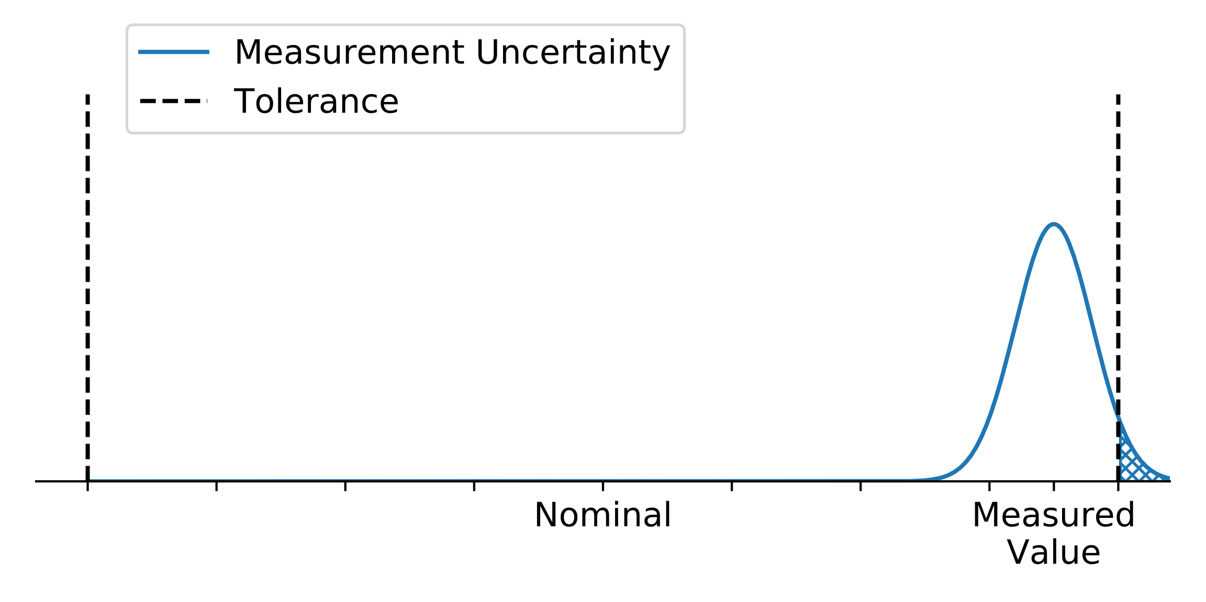
Measurement Decision
The True Value is never known because all measurements have uncertainty!

Slide 15
What is risk? (Metrologist’s definition)
Measurement Risk = Probability of accepting a bad DUT or rejecting a good DUT
Likelihood Tier | Consequence Tier
 | Catastrophic | Severe | Moderate | Low | Negligible
Very High | VH | VH | H | M | L
High | VH | H | M | M | L
Moderate | H | M | M | L | L
Low | M | M | L | L | N
Negligible | L | L | L | N | N
This course is concerned with quantifying and mitigating the probability of an undesirable outcome based on a measurement.
Measurement Risk is mitigated by 1) calibrating equipment and 2) Measurement Assurance Plans that determine and document this likelihood

Slide 16
Binary Decision Rule – Four possible outcomes
 | True Value In Tolerance | True Value Out of Tolerance
Measured Value PASS | True Accept | False Accept (Consumer Risk)
Measured Value FAIL | False Reject (Producer Risk) | True Reject

Slide 17
Question
Which of the following does not apply to the complete definition of risk?:
Undesirable Events
Likelihood or uncertainty of undesirable events
Guardbanding
Quantification of loss and affected parties due to those events

Slide 18
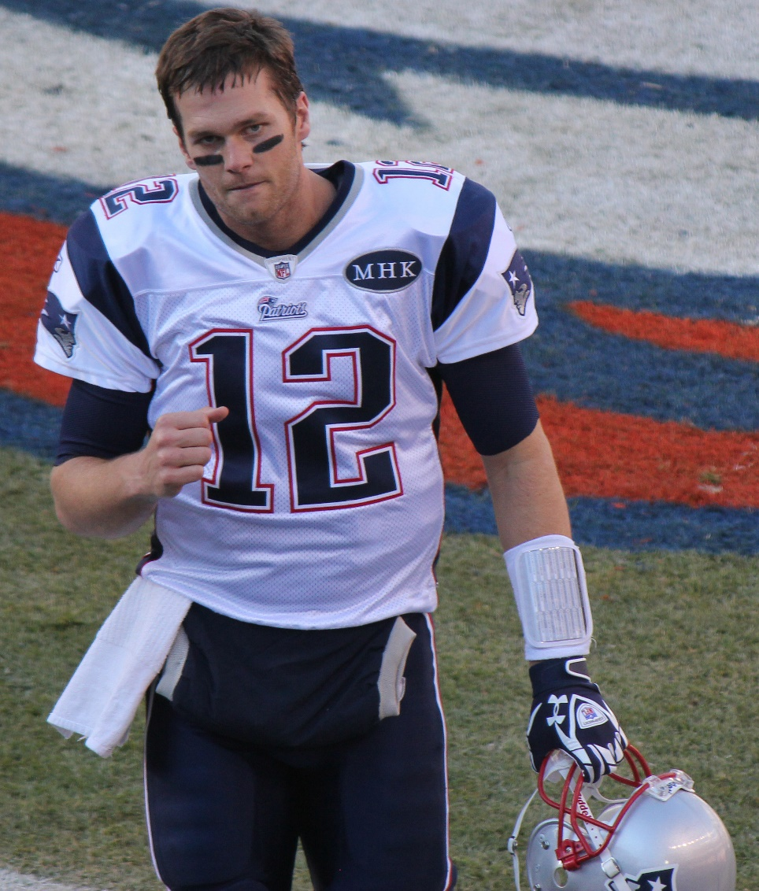
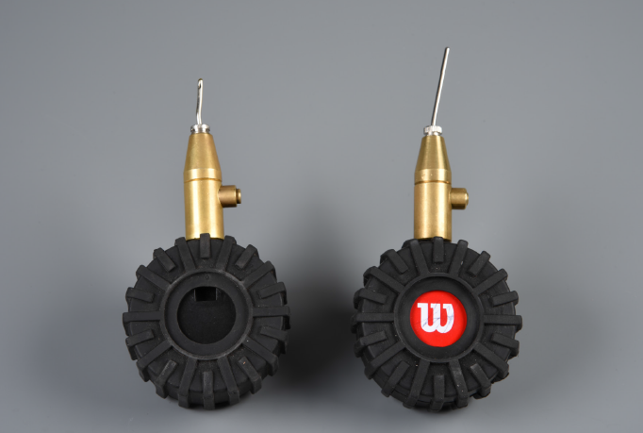
Consequences of Bad Measurements – Deflategate
Exponent Engineering: The Effect of Various Environmental and Physical Factors on the Measured Internal Pressure of NFL Footballs, 2015.
Jeffrey Beall/CC-BY-SA 4.0

Slide 19
Use a Measurement Assurance Plan to document measurement adequacy
Step 1 – List product requirements
NFL Rule Book
Q1. What quantity are you measuring? |  |  | Q2: How accurate do the measurements need to be? |  |  | Q3: How will you ensure your equipment can make this measurement?
Quantity Measured | MC | Requirement Number | Value or Range of Values Measured | Tolerance Limits | Guardbanded Acceptance Limit | Equipment Used (M&TE) | Measurement Uncertainty | TUR (>4 desired) | Calibrate (Yes/No)
Football Air Pressure | * | Rule 2, Section 1 | 13 "pounds" (psig) | ± 0.5 "pounds" (psig)

Slide 20
Use a Measurement Assurance Plan to document measurement adequacy
Step 2 – Evaluate the equipment and measurement uncertainty
Pressure gage uncertainty from analysis in Crowder, et. al.
Q1. What quantity are you measuring? |  |  | Q2: How accurate do the measurements need to be? |  |  | Q3: How will you ensure your equipment can make this measurement?
Quantity Measured | MC | Requirement Number | Value or Range of Values Measured | Tolerance Limits | Guardbanded Acceptance Limit | Equipment Used (M&TE) | Measurement Uncertainty | TUR (>4 desired) | Calibrate (Yes/No)
Football Air Pressure | * | Rule 2, Section 1 | 13 "pounds" (psig) | ± 0.5 "pounds" (psig) |  | Wilson (?) pressure gauge | ± 1 psig |  | Y

Slide 21
Use a Measurement Assurance Plan to document measurement adequacy
Step 3 – Calculate the Test Uncertainty Ratio (TUR).
TUR = (± Tolerance Limits)/(± Measurement Uncertainty @ 95%)
General rule: If TUR ≥ 4, the measurement is OK.
Q1. What quantity are you measuring? |  |  | Q2: How accurate do the measurements need to be? |  |  | Q3: How will you ensure your equipment can make this measurement?
Quantity Measured | MC | Requirement Number | Value or Range of Values Measured | Tolerance Limits | Guardbanded Acceptance Limit | Equipment Used (M&TE) | Measurement Uncertainty | TUR (>4 desired) | Calibrate (Yes/No)
Football Air Pressure | * | Rule 2, Section 1 | 13 "pounds" (psig) | ± 0.5 "pounds" (psig) |  | Wilson (?) pressure gauge | ± 1 psig | 0.5 | Y

Slide 22
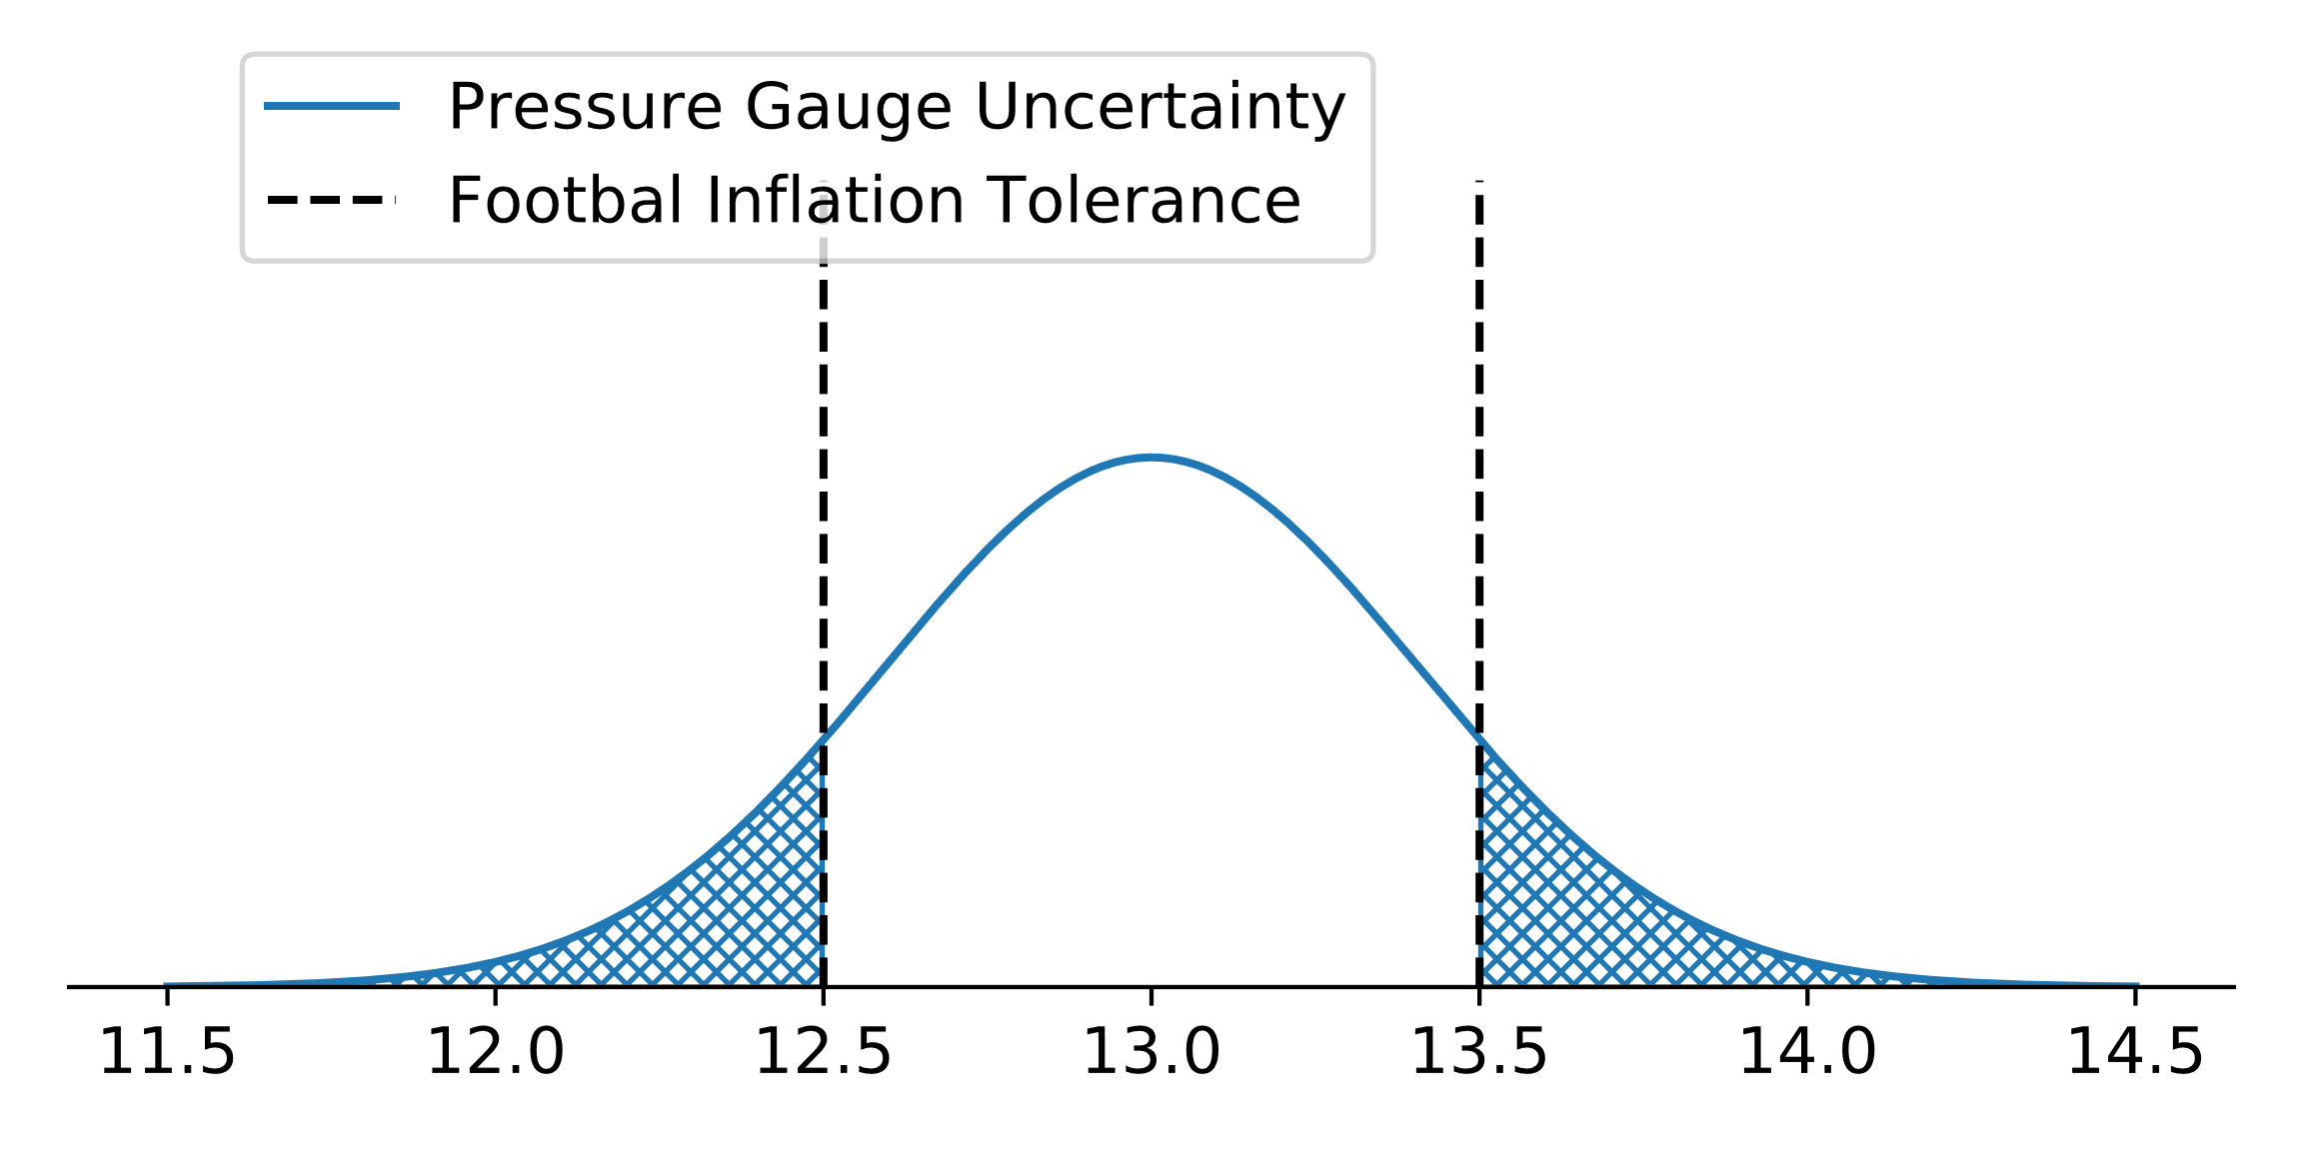
Deflategate Measurement – What happens when your TUR is too low
With a measured value of 13 psig, ~32% probability of a false accept!
Another questionable football measurement: what’s the uncertainty/risk when they “bring out the chains”?

Slide 23
What is this TUR thing, anyway?
The remainder of this class:
What’s so special about TUR > 4:1?
How do we calculate actual risk probabilities?
What if I’m very risk averse? Or very risk tolerant?
What if my manufacturing process is very tightly controlled? Or is very out of control? Or I have no idea what it is?
What about one-sided limits where TUR is not defined?

Slide 24
Requirements and Policy
ISO17025 7.8.6.1 – When a statement of conformity to a specification is provided, the laboratory shall document the decision rule employed, taking into account the level of risk (such as false accept and false reject).
ANSI/NCSL Z540.3 – the probability that incorrect acceptance decisions will result from calibration tests shall not exceed 2%. Where it is not practicable to estimate this probability, the TUR shall be equal to or greater than 4:1.
D&P Manual, 13.2 – ensure that the collective uncertainty of the measurement process (at a 95% level of confidence) shall not exceed 25% of the acceptable tolerance (e.g. manufacturer’s specification) for each characteristic of the M&TE being certified, unless an appropriate guard banding technique is used.
R028, FR79985 - The measurement uncertainty (at a coverage probability of 95%) is at least four times lower than the M&TE being calibrated, OR a guardbanding method is used to reduce the global false accept rate to below 1% (see Appendix H)
General Specification 9900000 – When test accuracy ratios (TAR) of 4:1 or greater are maintained, the resulting values can be directly compared to the specified limits.
Notes:
* 9.9M makes the unfortunate use of “Test Accuracy Ratio” where the rest of the world uses “Test Uncertainty Ratio” to mean the same thing.

Slide 25
Question
M.C.
How is the TUR defined?
(± Mean)/(± Measurement Uncertainty)
(± Measurement Uncertainty)/(± Tolerance Limits)
(± Tolerance Limits)/(± Guardband)
(± Tolerance Limits)/(± Measurement Uncertainty)

Slide 26
Section 2 Specific and Global Risk
Calculating risk probabilities

Slide 27
Section 2– Specific and Global Risk
Objective
Define and give examples of “specific risk”, “global risk”, and calculate probability of conformance, probability of false accept, and probability of false reject.
Content
Review of measurement uncertainty
Probability of Conformance
Incorrect Decision Making
Specific Risk
Global Risk
Software for Risk Evaluation

Slide 28
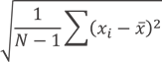
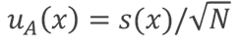
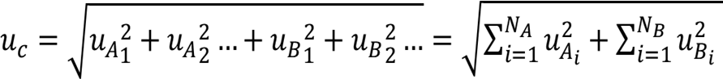
Type A and Type B Uncertainty Evaluation
Type A: Uncertainty derived from statistical analysis of current test data
Estimate the bell curve using measurements
Std Dev:
Std Uncertainty:
Type B: Uncertainty derived from other sources
Assign a probability distribution and normalize it:
Normal: Given ±U with confidence and/or k value… 𝑢 = 𝑈/𝑘
Uniform: Given ±U with no other information... 𝑢 = 𝑎/√3
Triangular: Given ±U, but more likely to be near center… 𝑢 = 𝑎/√6
A full uncertainty evaluation for direct measurements requires both Type A and Type B:
Notes:
Point to Engineering 224 – whole day class all in this slide

Slide 29
Question
T/F
Manufacturer's specifications for vertical accuracy would fall under Type B measurement uncertainty
T
F
Notes:
T

Slide 30
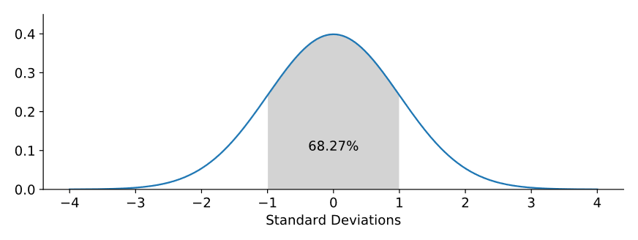
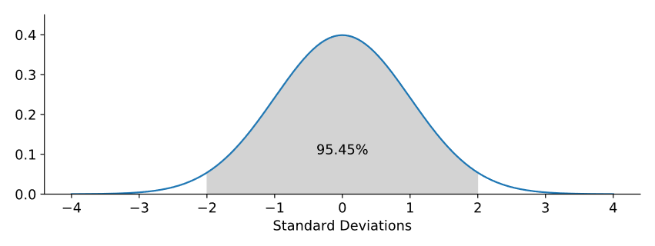

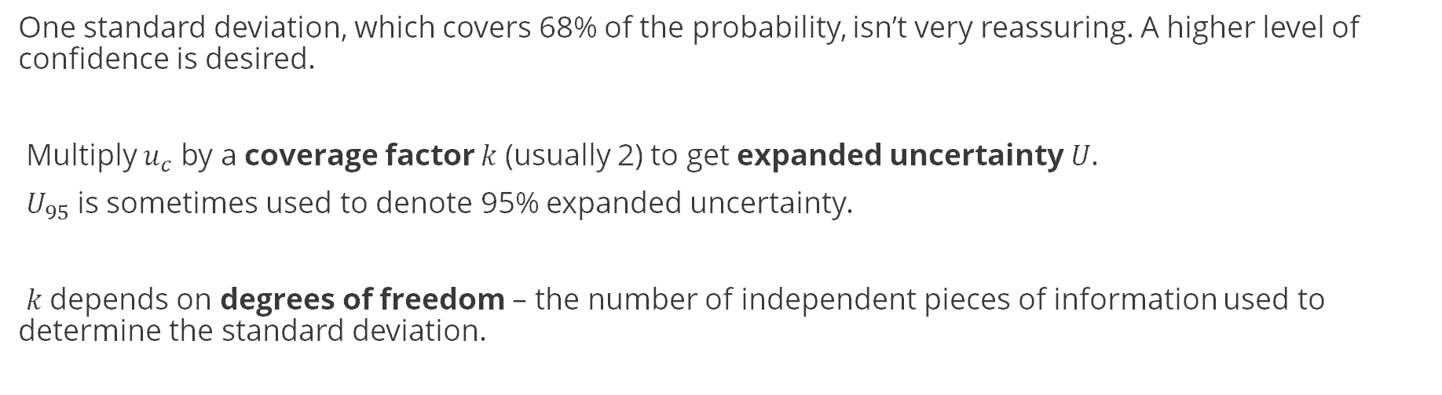
Expanded Uncertainty
One standard deviation, which covers 68% of the probability, isn’t very reassuring. A higher level of confidence is desired.
Multiply $u_{c}$ by a coverage factor 𝑘 (usually 2) to get expanded uncertainty 𝑈.
$U_{95}$ is sometimes used to denote 95% expanded uncertainty.
𝑘 depends on degrees of freedom – the number of independent pieces of information used to determine the standard deviation.
Notes:
The RSS formula on the slide before is not the end of the story. We need more confidence in our measurements. It is the 95.5% expanded uncertainty that we will be working with in our risk calculations.
It is the same probability distribution with 2 different ways of describing it.

Slide 31
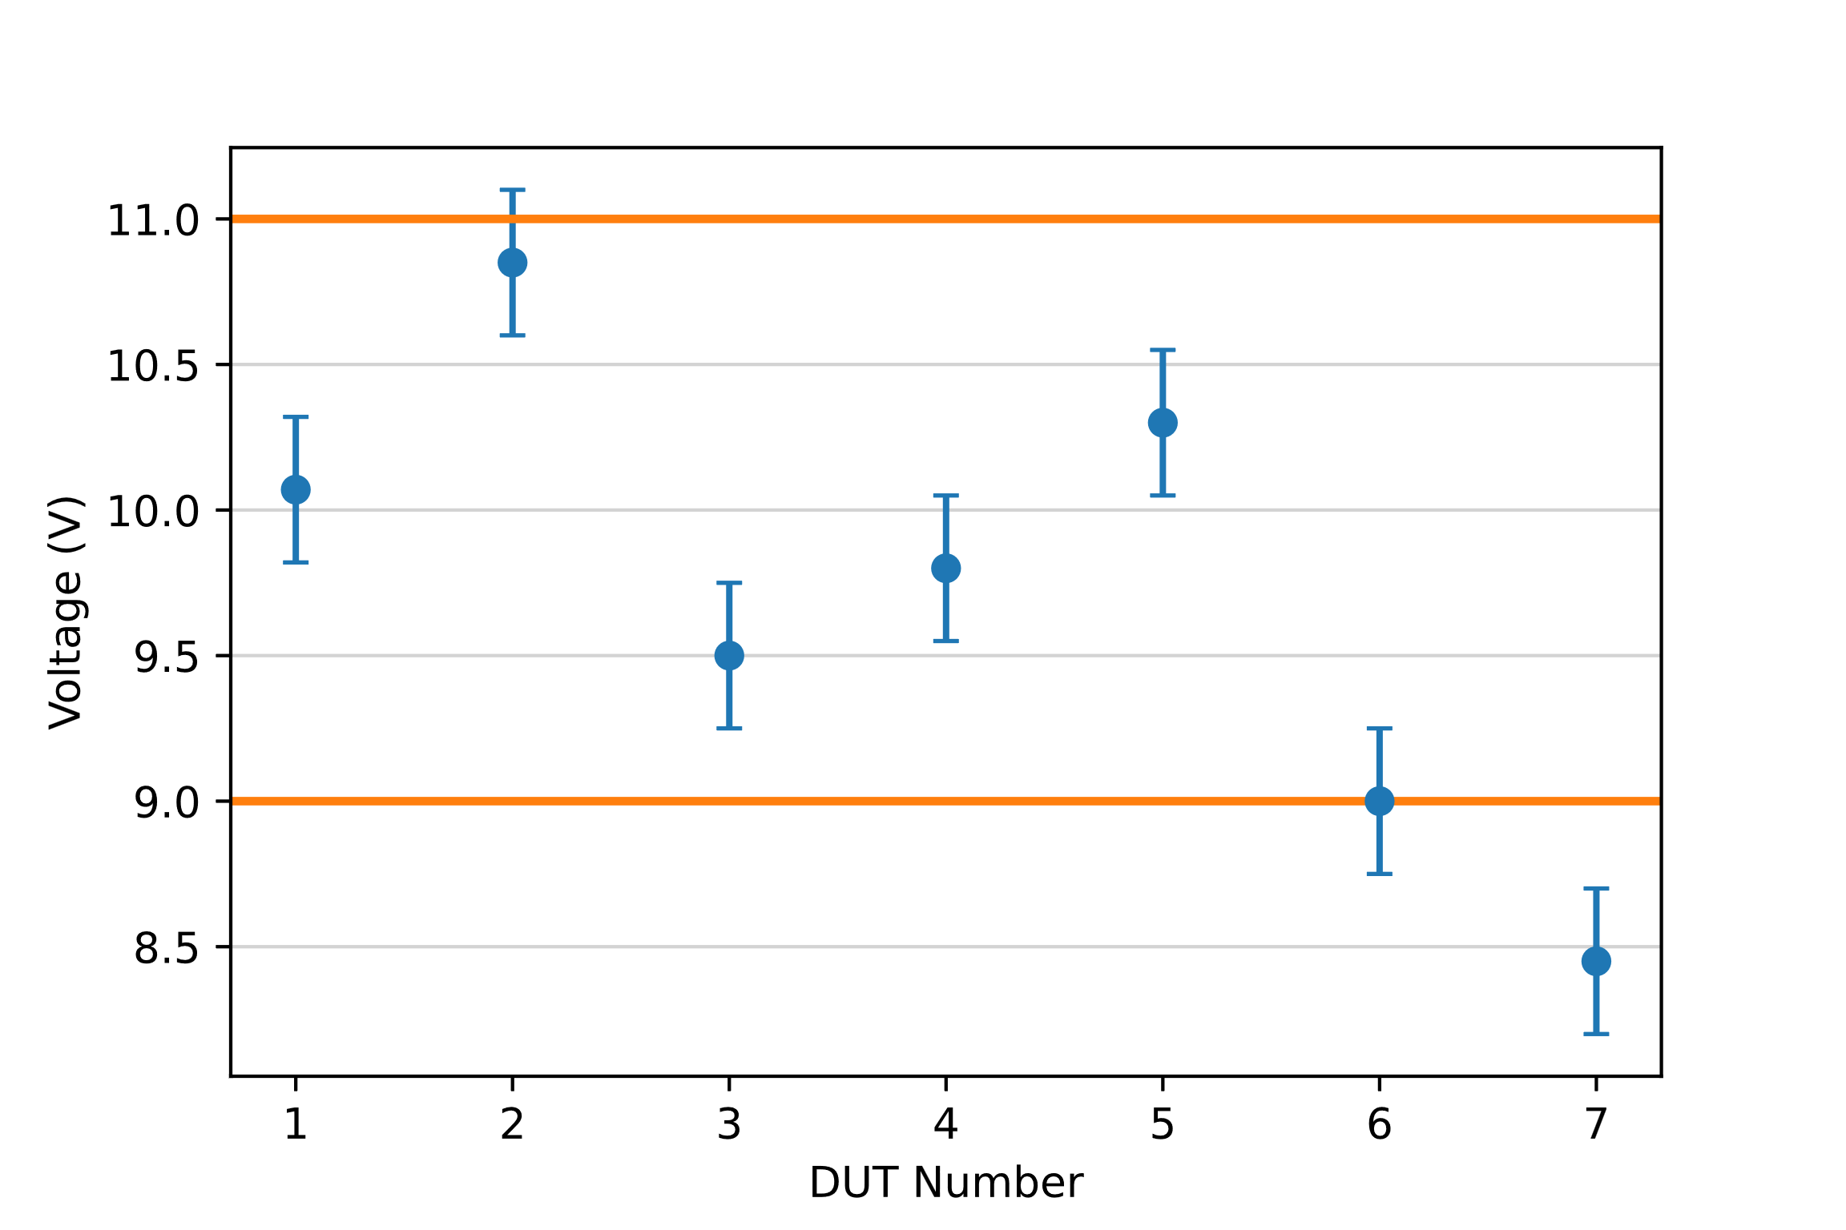
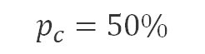
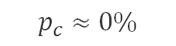
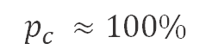
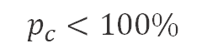
Probability of Conformance ($p_{c}$)
Given a measurement result (with uncertainty), what is the probability the device under test (DUT) meets requirements?
$$p_{c}<100\%$$
$$p_{c} ≈100\%$$
$$p_{c}=50\%$$
$$p_{c}≈0\%$$
Notes:
Use it to make a decision
You can come up with the Pc and you can use that to make a Pass/Fail decision.
Probability of conformance is basically whether or not your device of interest is going to meet required specifications

Slide 32
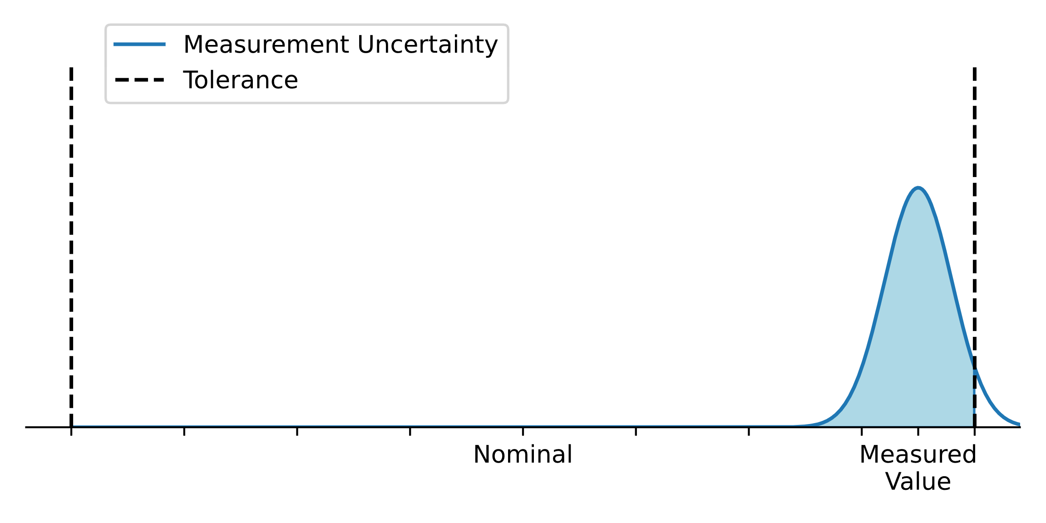
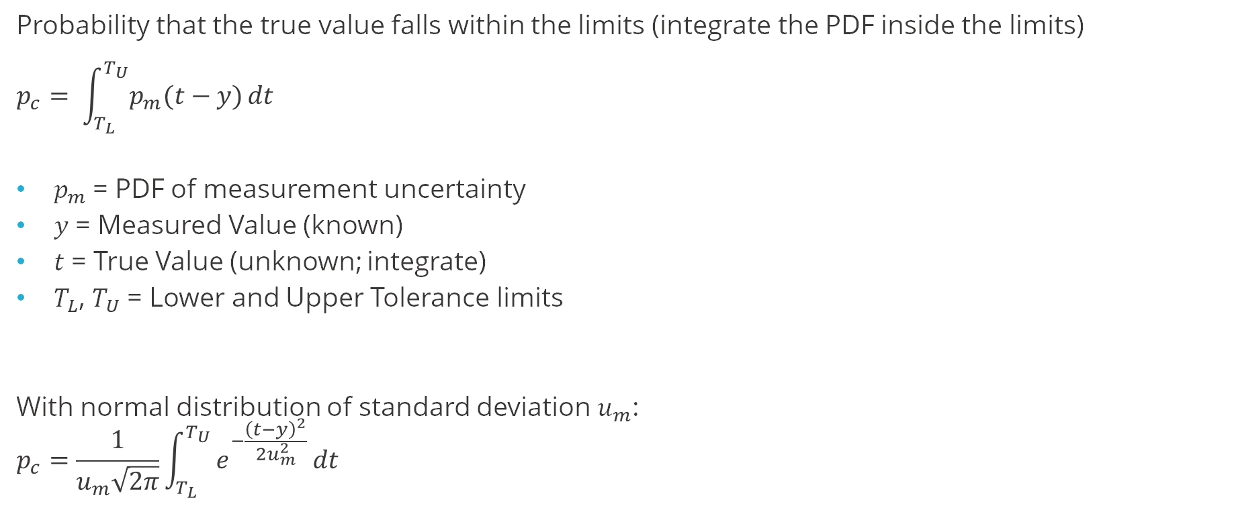
Probability of Conformance – Quantified
Probability that the true value falls within the limits (integrate the PDF inside the limits)
$$p_{c}= \int_{T_{L}}^{T_{U}}{p_{m}(t−y)}dt$$
$p_{m}$= PDF of measurement uncertainty
𝑦 = Measured Value (known)
𝑡 = True Value (unknown; integrate)
$T_{L}$, $T_{U}$ = Lower and Upper Tolerance limits
With normal distribution of standard deviation $u_{m}$:
$$p_{c}=\frac{1}{u_{m}\sqrt{2π}}\int_{T_{L}}^{T_{U}}{e^{−\frac{{\left(t−y\right)}^{2}}{2u_{m}^{2}}}}dt$$
T_{L}
T_{U}
y
u_{m}
In Excel (one side): “NORM.DIST(TU, y, um, TRUE)”
Notes:
Make sure to mention there is a built-in excel function for this
Excel question: TRUE (talks about is it a CDF or PDF? We want the CDF)

Slide 33
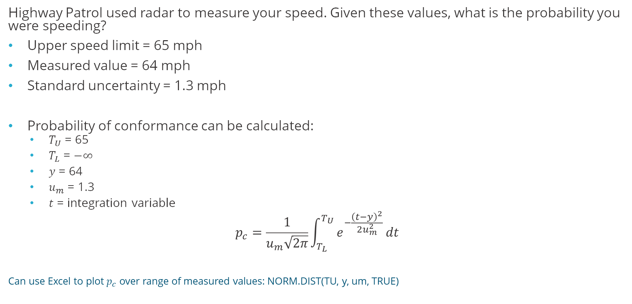
Example – Speed Limit Enforcement (Example 1 in JCGM106)
Highway Patrol used radar to measure your speed. Given these values, what is the probability you were speeding?
Upper speed limit = 65 mph
Measured value = 64 mph
Standard uncertainty = 1.3 mph
Probability of conformance can be calculated:
$T_{U}$ = 65
$T_{L}$ = $−∞⁡$
$y$ = 64
$u_{m}$ = 1.3
$t$ = integration variable
$$p_{c}=\frac{1}{u_{m}\sqrt{2π}}\int_{T_{L}}^{T_{U}}{e^{−\frac{{\left(t−y\right)}^{2}}{2u_{m}^{2}}}}dt$$
Can use Excel to plot $p_{c}$ over range of measured values: NORM.DIST(TU, y, um, TRUE)
Notes:
JCGM106 Example 1 given in SI units, here converted to Imperial since that’s how speeds are done in the U.S.

Slide 34
Probability of Conformance Plot – Speed Limit Enforcement
High confidence you’re not speeding
Uncertain region
High confidence you are speeding
Notes:
Can be useful for finding a guardband – ie find measured value that produces minimum acceptable p_c.
The problems occur when measured value is near the limits where we’re not 100% sure the UUT passes or fails

Slide 35
Probability of Conformance Plot – Speed Limit Enforcement
Can use this plot to find thresholds that give confidence
Notes:
Can be useful for finding a guardband – ie find measured value that produces minimum acceptable p_c.
The problems occur when measured value is near the limits where we’re not 100% sure the UUT passes or fails

Slide 36
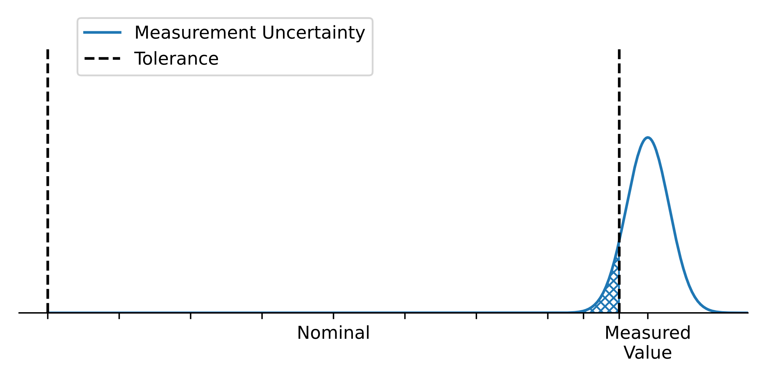
Specific Risk – adds a decision to the measurement result
Specific Risk: probability that a decision based on a specific measurement result is incorrect
Specific false accept: decision = pass; true value = fail
Specific false reject: decision = fail; true value = pass
Specific risk is found by integrating the shaded area – outside the limits (False Accept) or inside the limits (False Reject).
PFA
PFR
Mostly pass, but some fail. I.e., the decision was pass, but it could have failed
Mostly fail, but some pass. I.e., the decision was fail, but it could have passed
Notes:
Sometimes called conditional risk – conditioned on a particular measured value
Stress that this type of risk is based on a single measurement alone
Very similar to probability of conformance, but the decision has been made. You are now integrating outside of the limits of the PDF.
Left side is 1-Pc

Slide 37
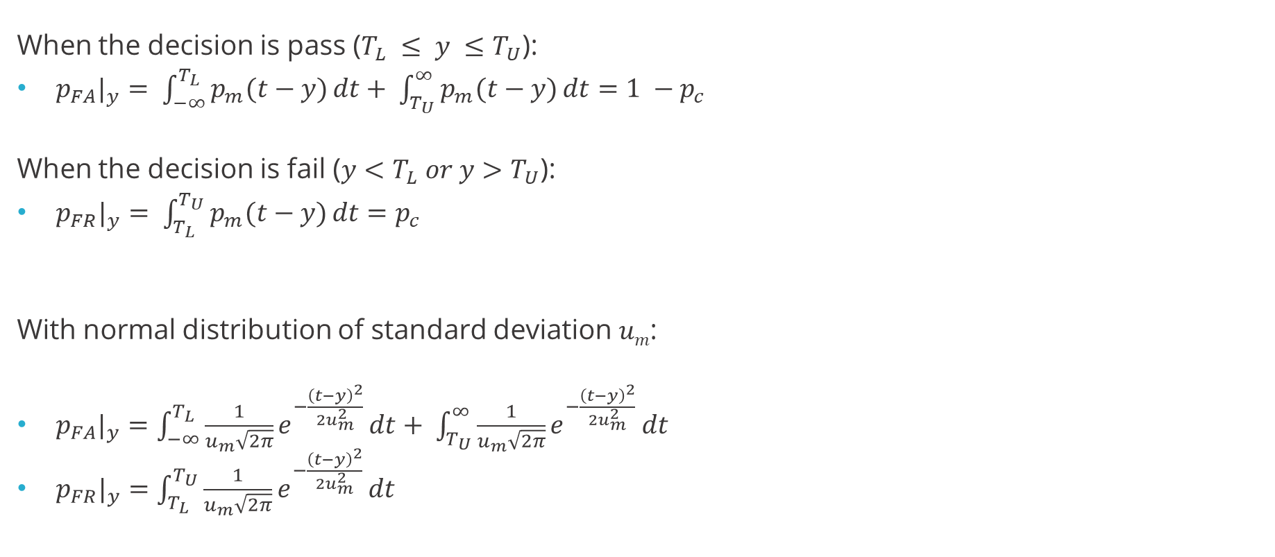
Specific Risk – Quantified
When the decision is pass ($T_{L} ≤ y ≤T_{U}$):
$p_{FA}|_{y}= \int_{−∞}^{T_{L}}{p_{m}(t−y)}dt+ \int_{T_{U}}^{∞}{p_{m}(t−y)}dt=1 −p_{c}$
When the decision is fail ($y<T_{L} or y>T_{U}$):
$p_{FR}|_{y}= \int_{T_{L}}^{T_{U}}{p_{m}(t−y)}dt=p_{c}$
With normal distribution of standard deviation 𝑢_{𝑚}:
$p_{FA}|_{y}=\int_{−∞}^{T_{L}}{\frac{1}{u_{m}\sqrt{2π}}e^{−\frac{{\left(t−y\right)}^{2}}{2u_{m}^{2}}}}dt+ \int_{T_{U}}^{∞}{\frac{1}{u_{m}\sqrt{2π}}e^{−\frac{{\left(t−y\right)}^{2}}{2u_{m}^{2}}}}dt$
$p_{FR}|_{y}=\int_{T_{L}}^{T_{U}}{\frac{1}{u_{m}\sqrt{2π}}e^{−\frac{{\left(t−y\right)}^{2}}{2u_{m}^{2}}}}dt$
T_{L}
T_{U}
y
u_{m}
In Excel (one side): “1 - NORM.DIST(TU, y, um, TRUE)”
Notes:
For PFA
The first term finds probability that true value is less than LL – is essentially zero in the figure
Second term finds probability that true value is greater than UL – the shaded area
For PFR
???

Slide 38
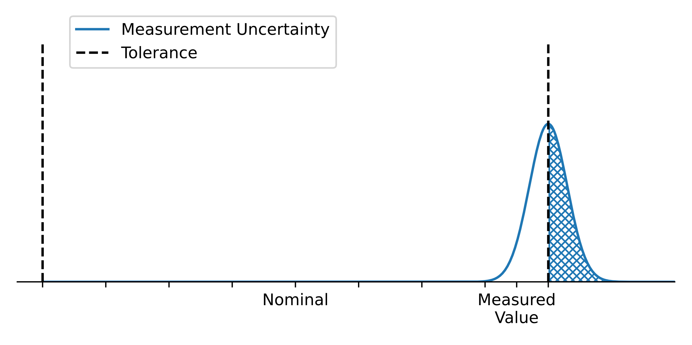
Risk Probability
There can be a 50% risk my measurement decision is wrong?!
Most DUTs should be near here
Yes, but…
Low probability of finding a DUT here
Notes:
Make a measurement right on the limit. That means 50/50 the measurement is in or out...
That is why we cannot stop at specific risk .

Slide 39
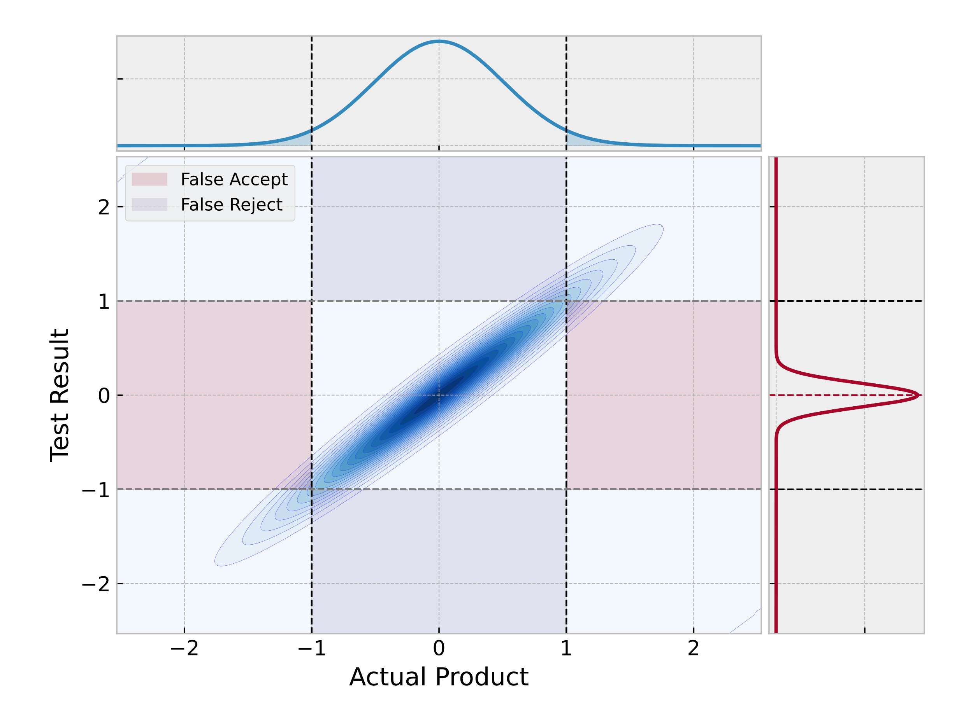
Global Risk
Global Risk combines these two probabilities – the PDF of the measurement uncertainty and the PDF of all the DUTs being measured
Measurement shows acceptable
Actual product is acceptable
Notes:
TUR-based risk analysis tends to make assumptions about the product PDF!
X-axis first which shows the product distribution
Y-axis which shows the measurement distribution (depends on the product)
These are not independent. If we had no uncertainty, we would see a straight line (y=x). we would never get into the false accept/reject regions at all.
Because we have measurement uncertainty, we see an ellipse. The 3-D regions we see the false accept/reject regions. And that is where we have the risk.
No uncertainty = no risk.

Slide 40
Global Risk
Measurement uncertainty PDF: get from uncertainty analysis (i.e. GUM methods)
Product PDF: Need prior information about the DUTs!
Historical data on DUTs of same or similar design
Observed Out of Tolerance (OOT) rate of same or similar calibration assets
Information from manufacturing process
Details in next section…
Notes:
This slide talks about what information you need to calculate the global risk.
We need to quantify the two distributions

Slide 41

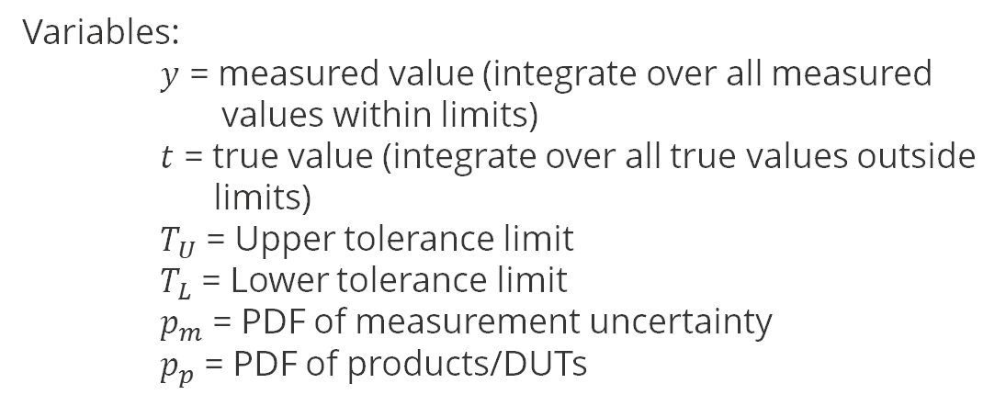
Global Risk – Quantified (Equation 19 and 20 in JCGM106)
Global Probability of False Accept (PFA):
The inside integral (TL to TU) is integrating the "correct accept" regions.
The outside integral (-∞ to TL) is integrating the "fail" regions
On the LHS.
(TU to +∞) is integrating the "fail" regions RHS
$$\begin{aligned}& \\ PFA=\int_{−∞}^{T_{L}}{\int_{T_{L}}^{T_{U}}{p_{m}\left(t−y\right) p_{p}\left(t\right) dy}dt+\int_{T_{U}}^{+∞}{\int_{T_{L}}^{T_{U}}{p_{m}\left(t−y\right) p_{p}\left(t\right) dy}dt}}\end{aligned}$$
False Reject
Correct Rejects
Variables:
$y$ = measured value (integrate over all measured values within limits)
$t$ = true value (integrate over all true values outside limits)
$T_{U}$ = Upper tolerance limit
$T_{L}$ = Lower tolerance limit
$p_{m}$ = PDF of measurement uncertainty
$p_{p}$ = PDF of products/DUTs
False Accept
Correct Accepts
False Accept
Correct Rejects
False Reject
In Excel: Not easy. Can be done numerically or by Monte-Carlo.
Notes:
Rarely an analytical solution to the integrals. No analytical solution with normal distributions
Integrating the 2 probabilities (blue ellipse). We want to know how much of the ellipse falls into the "false" regions.
First set of double integrals.
Upper and lower limits, up and down between the test results.
Negative inifity to the limit on the product showing that the product is below the limit
Next set of intgerals up and down
Showing that the prodyct is above the limit, right hand reddish box

Slide 42
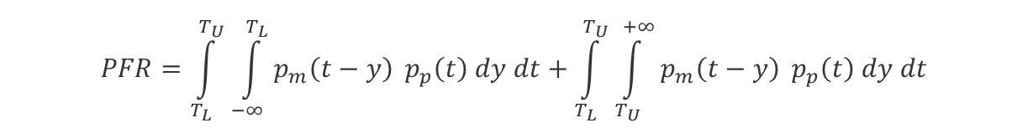
Global Risk – Quantified (Equation 19 and 20 in JCGM106)
Global Probability of False Reject (PFR):
The inside integral (TL to TU) is integrating the "correct accept" regions.
The outside integral (-∞ to TL) is integrating the "fail" regions
On the LHS.
(TU to +∞) is integrating the "fail" regions RHS
$$\begin{aligned}& \\ PFR=\int_{T_{L}}^{T_{U}}{\int_{−∞}^{T_{L}}{p_{m}\left(t−y\right)} p_{p}\left(t\right) dy dt+\int_{T_{L}}^{T_{U}}{\int_{T_{U}}^{+∞}{p_{m}\left(t−y\right)} p_{p}\left(t\right) dy dt}}\end{aligned}$$
False Reject
Correct Rejects
Variables:
$y$ = measured value (integrate over all measured values within limits)
$t$ = true value (integrate over all true values outside limits)
$T_{U}$ = Upper tolerance limit
$T_{L}$ = Lower tolerance limit
$p_{m}$ = PDF of measurement uncertainty
$p_{p}$ = PDF of products/DUTs
False Accept
Correct Accepts
False Accept
Correct Rejects
False Reject
In Excel: Not easy. Can be done numerically or by Monte-Carlo.
Notes:
First set of double integrals.
Upper and lower limits, side to side measurement side is below the limit
Integrating between the upper and lower limits on the product side
Next set of side to side to show that the measurement is above the limit
Between upper and lower limits on the product side

Slide 43
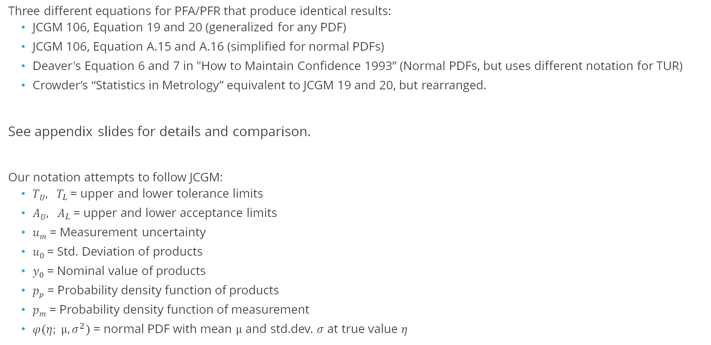
Some common variations on PFA/PFR equations
Three different equations for PFA/PFR that produce identical results:
JCGM 106, Equation 19 and 20 (generalized for any PDF)
JCGM 106, Equation A.15 and A.16 (simplified for normal PDFs)
Deaver's Equation 6 and 7 in "How to Maintain Confidence 1993” (Normal PDFs, but uses different notation for TUR)
Crowder’s “Statistics in Metrology” equivalent to JCGM 19 and 20, but rearranged.
See appendix slides for details and comparison.
Our notation attempts to follow JCGM:
$TU, T_{L}$= upper and lower tolerance limits
$AU, A_{L}$= upper and lower acceptance limits
$um$ = Measurement uncertainty
$u0$ = Std. Deviation of products
$y0$ = Nominal value of products
$pp$ = Probability density function of products
$pm$ = Probability density function of measurement
$φ(η; μ, σ^{2})$ = normal PDF with mean $μ$ and std.dev. $σ$ at true value $η$
Notes:
PFA = Probability of false accept
PFR = Probability of false reject
All compute the same way and give the same result, but the input notation is different!

Slide 44
Question
What does global risk consider that specific risk does not?
Distribution of products
Measurement uncertainty
Tolerance limits
One measured value
Notes:
A.

Slide 45
Exercise – Voltmeter calibration
Manufacturer’s specification on a voltmeter at reading 10.00 V is ± 0.05 V
Historical calibration data on this model of meter shows a 10 % out-of-tolerance rate. In other words, the DUTs follow a distribution of μ = 10.00 V and σ = 0.03 V.
The k = 1 uncertainty (standard deviation) in the calibration measurement is 0.010 V.
Calculate the probability of false accept and probability of false reject for any voltmeter of this model.
Notes:
We’ll show how to go from 5% to 0.03V in later section.

Slide 46
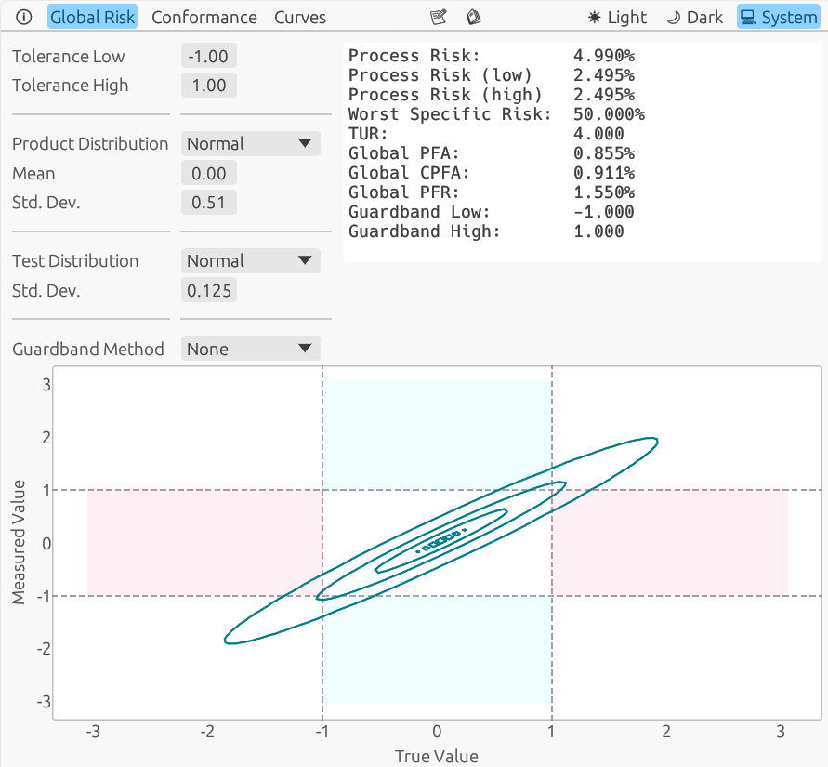
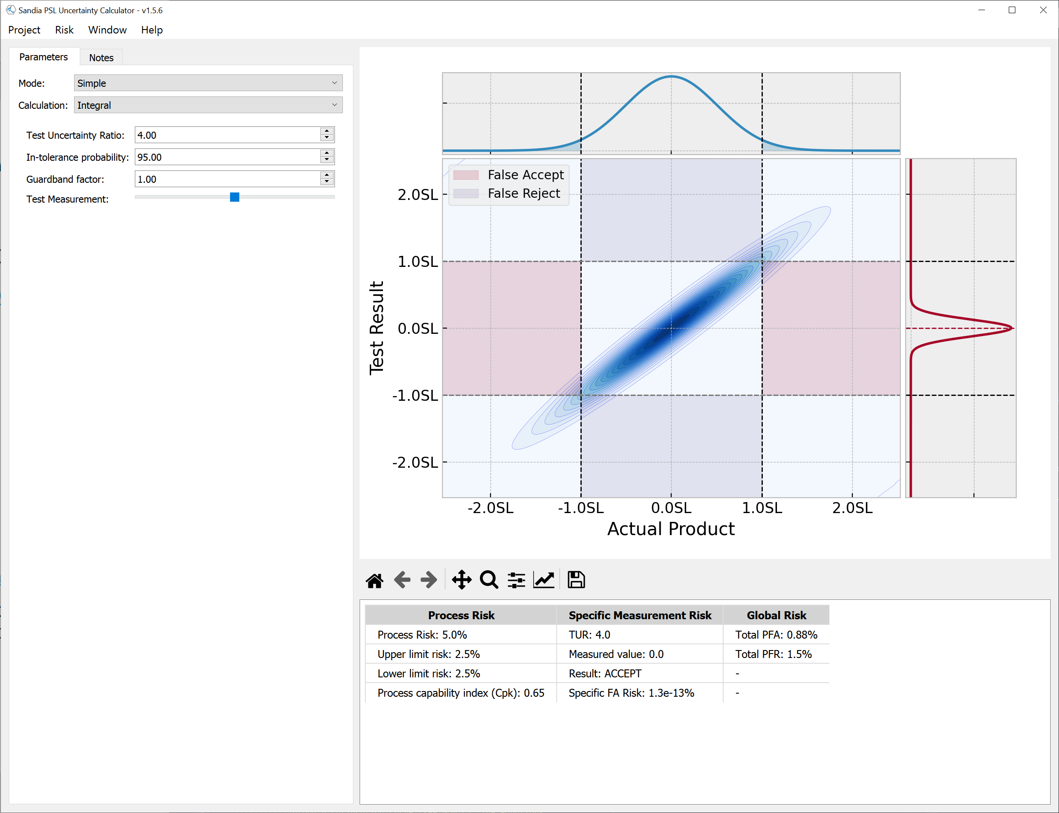
Software to the rescue!
Sandia Uncertainty Calculator (Suncal)
https://sandiapsl.github.io
Use Online version for this class:
https://sandialabs.github.io/suncal/suncal/risk/
See Appendix slides for usage notes.
Notes:
How to get the 3D model?

Slide 47
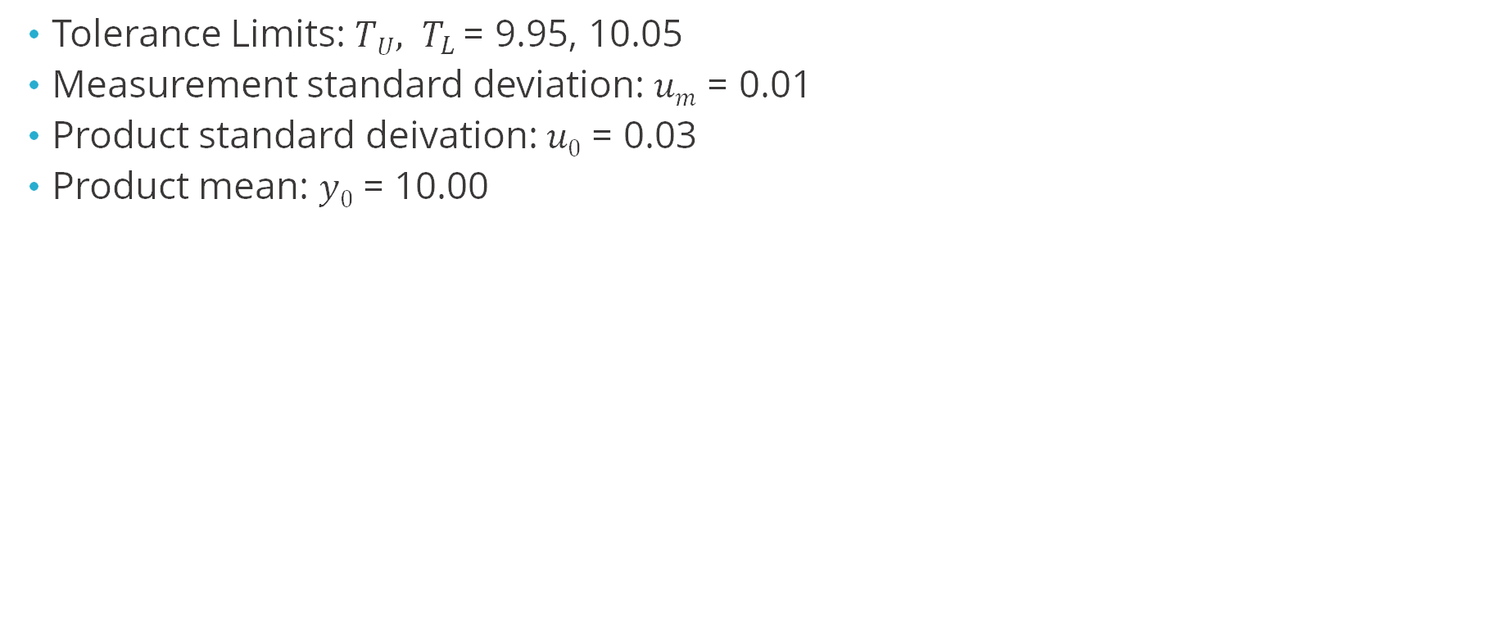
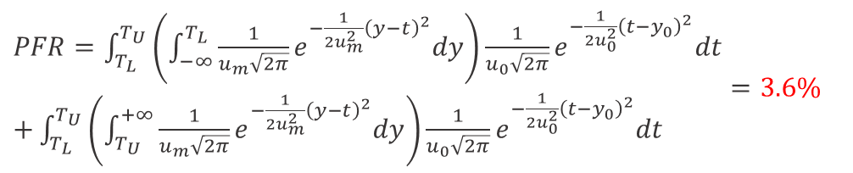
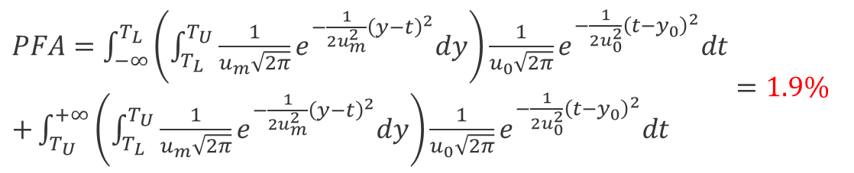
Exercise – Use Suncal to calculate PFA and PFR of voltmeter problem
Tolerance Limits: $TU, T_{L}$= 9.95, 10.05
Measurement standard deviation: $um$ = 0.01
Product standard deivation: $u0$ = 0.03
Product mean: $y0$ = 10.00
$\begin{aligned}&PFA=\int_{−∞}^{T_{L}}{\left(\int_{T_{L}}^{T_{U}}{{\frac{1}{u_{m}\sqrt{2π}}e}^{−{\frac{1}{2u_{m}^{2}}\left(y−t\right)}^{2}}dy}\right){\frac{1}{u_{0}\sqrt{2π}}e}^{−{\frac{1}{2u_{0}^{2}}\left(t−y_{0}\right)}^{2}}dt} \\ &+\int_{T_{U}}^{+∞}{\left(\int_{T_{L}}^{T_{U}}{{\frac{1}{u_{m}\sqrt{2π}}e}^{−{\frac{1}{2u_{m}^{2}}\left(y−t\right)}^{2}}dy}\right){\frac{1}{u_{0}\sqrt{2π}}e}^{−{\frac{1}{2u_{0}^{2}}\left(t−y_{0}\right)}^{2}}dt}\end{aligned}=1.9\%$
$\begin{aligned}&PFR=\int_{T_{L}}^{T_{U}}{\left(\int_{−∞}^{T_{L}}{{\frac{1}{u_{m}\sqrt{2π}}e}^{−{\frac{1}{2u_{m}^{2}}\left(y−t\right)}^{2}}dy}\right){\frac{1}{u_{0}\sqrt{2π}}e}^{−{\frac{1}{2u_{0}^{2}}\left(t−y_{0}\right)}^{2}}dt} \\ &+\int_{T_{L}}^{T_{U}}{\left(\int_{T_{U}}^{+∞}{{\frac{1}{u_{m}\sqrt{2π}}e}^{−{\frac{1}{2u_{m}^{2}}\left(y−t\right)}^{2}}dy}\right){\frac{1}{u_{0}\sqrt{2π}}e}^{−{\frac{1}{2u_{0}^{2}}\left(t−y_{0}\right)}^{2}}dt} \end{aligned}=3.6\%$

Slide 48
Section 3 Historical Product Data
Determining the product distribution

Slide 49
Section 3 – Historical Product Data
Objective
Determine appropriate probability distributions and parameters based on prior knowledge about a measurement and process
Content
Estimating product distribution in calibration labs
Estimating product distribution in manufacturing

Slide 50
Information needed to calculate risk (“prior knowledge”)
Tolerance Limits (engineering/design)
Measurement distribution (measurement uncertainty analysis – GUM)
Product distribution (knowledge of manufacturing or calibration process)

Slide 51
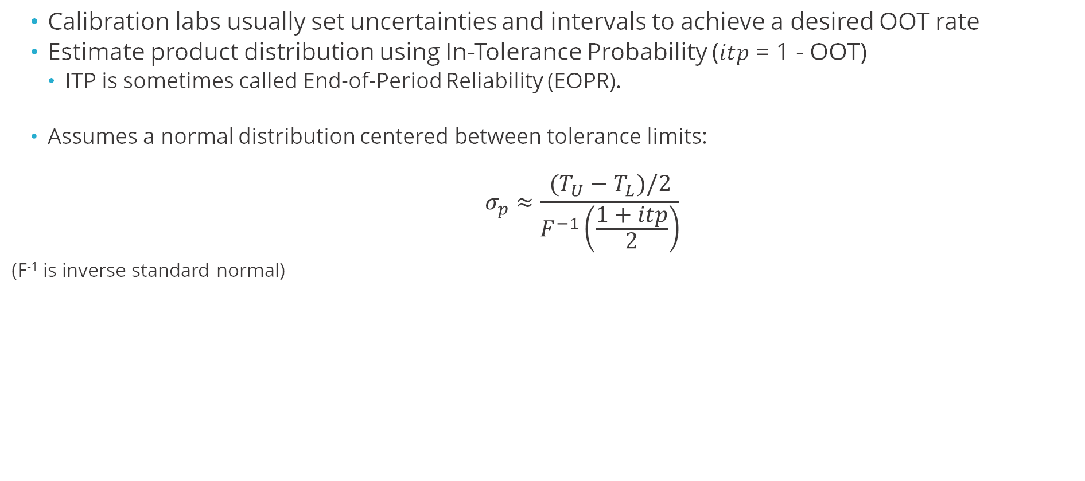
Where do we get the product distribution in Calibration Labs?
Calibration labs usually set uncertainties and intervals to achieve a desired OOT rate
Estimate product distribution using In-Tolerance Probability ($itp$ = 1 - OOT)
ITP is sometimes called End-of-Period Reliability (EOPR).
Assumes a normal distribution centered between tolerance limits:
$$σ_{p}≈\frac{(T_{U}−T_{L})/2}{F^{−1}\left(\frac{1+itp}{2}\right)}$$
(F⁻¹ is inverse standard normal)
Notes:
What assumptions does this make? – Normal, true value centered at nominal, ITP estimate is accurate/representative of population
Equation Reference: Dobbert Guardbanding Strategy
That's why the approximate sign is in the equation.
PSL sets a 5% OOT rate.

Slide 52
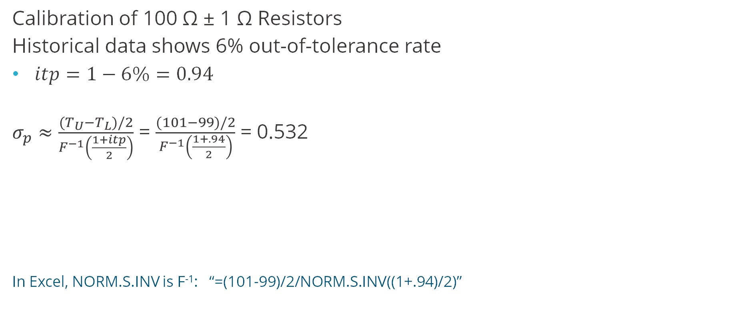
Example – Estimating Product Distribution from ITP
Calibration of 100 Ω ± 1 Ω Resistors
Historical data shows 6% out-of-tolerance rate
$itp=1−6\%=0.94$
$σ_{p}≈\frac{(T_{U}−T_{L})/2}{F^{−1}\left(\frac{1+itp}{2}\right)}$ = $\frac{(101−99)/2}{F^{−1}\left(\frac{1+.94}{2}\right)}$ = 0.532
In Excel, NORM.S.INV is F⁻¹: “=(101-99)/2/NORM.S.INV((1+.94)/2)”
Notes:
In excel you need to have an inverse normal, which is what makes using a standard calculator difficult to use for this

Slide 53
Where do we get the product distribution in Manufacturing?
Measure a sample of the manufactured parts, preferably with highly accurate measurement
Characterize the sample data (mean 𝜇, standard deviation 𝑠)
Make a histogram of product sample
Fit a probability distribution to the histogram
Common choices:
Normal distribution – the default choice
Lognormal distribution – many physical growth processes; reliability data
Gamma distribution – useful for values that must be positive, but are near zero (see JCGM106 B.3)
Notes:
Will use gamma distribution in a later example
See Mimbs Z540 for discussion of “observed” vs “true” EOPR – accounting for measurement uncertainty in determining the product distribution

Slide 54
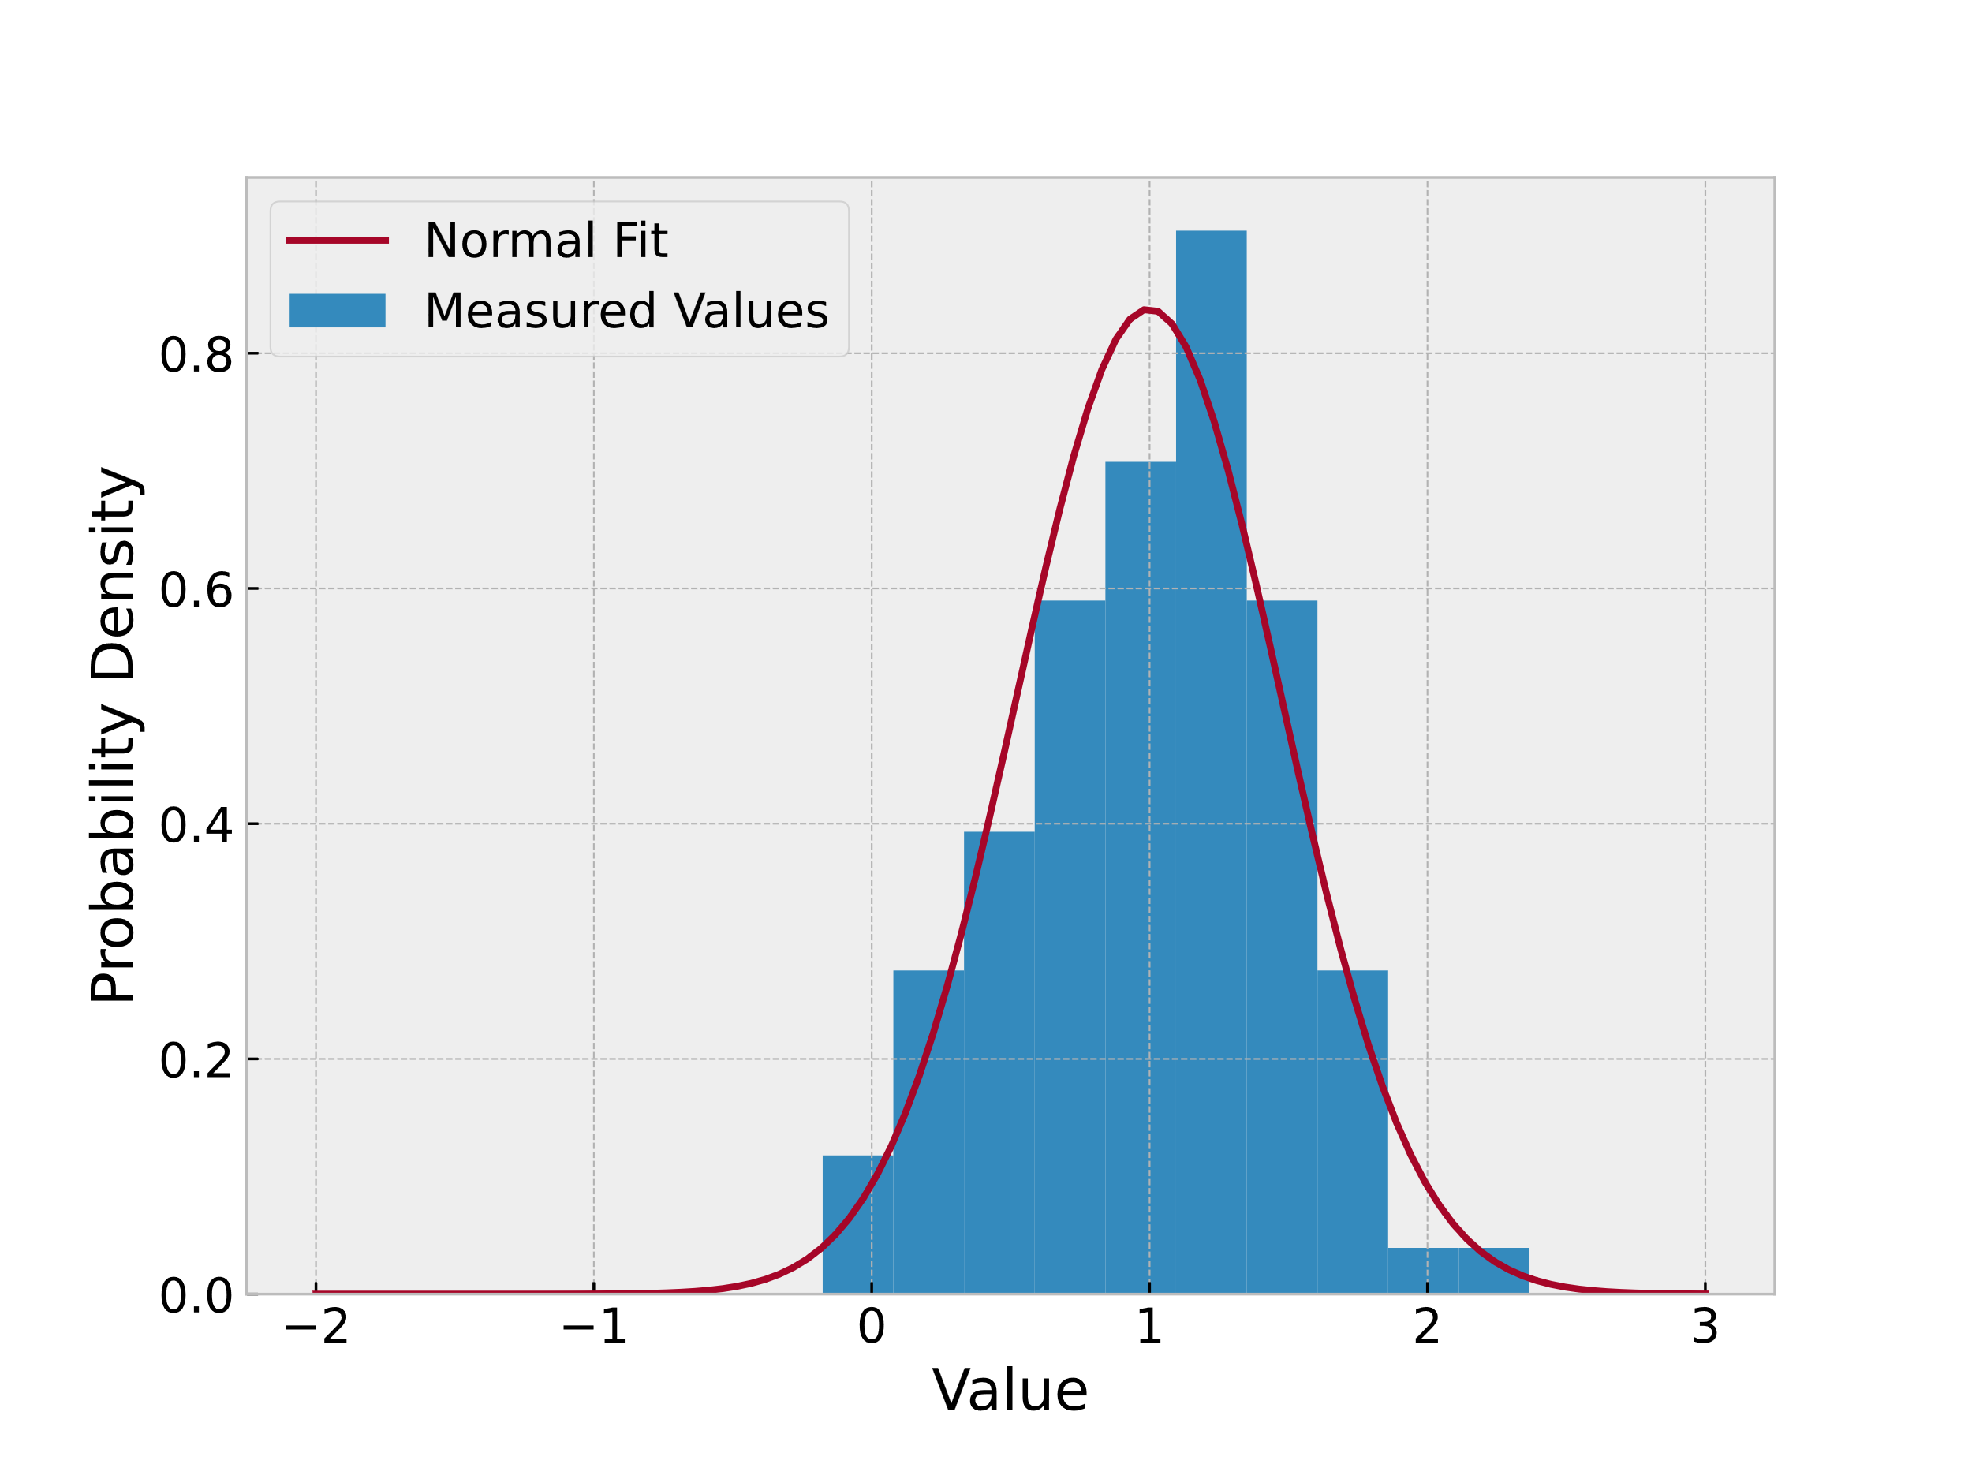
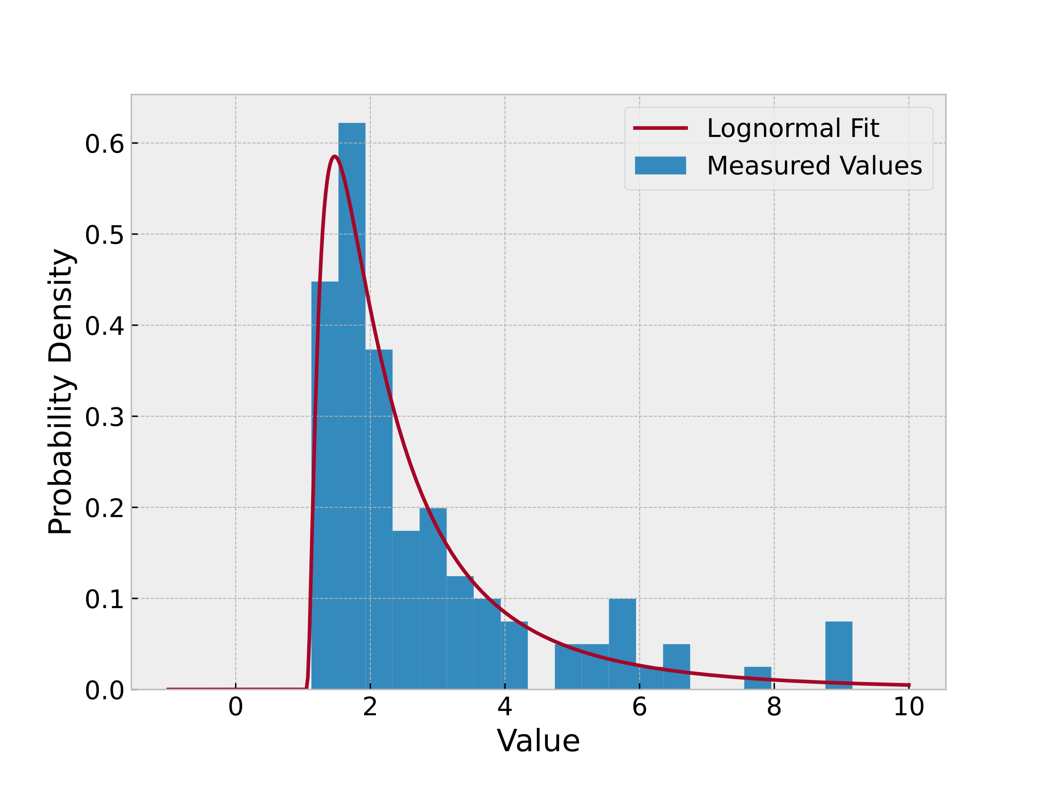
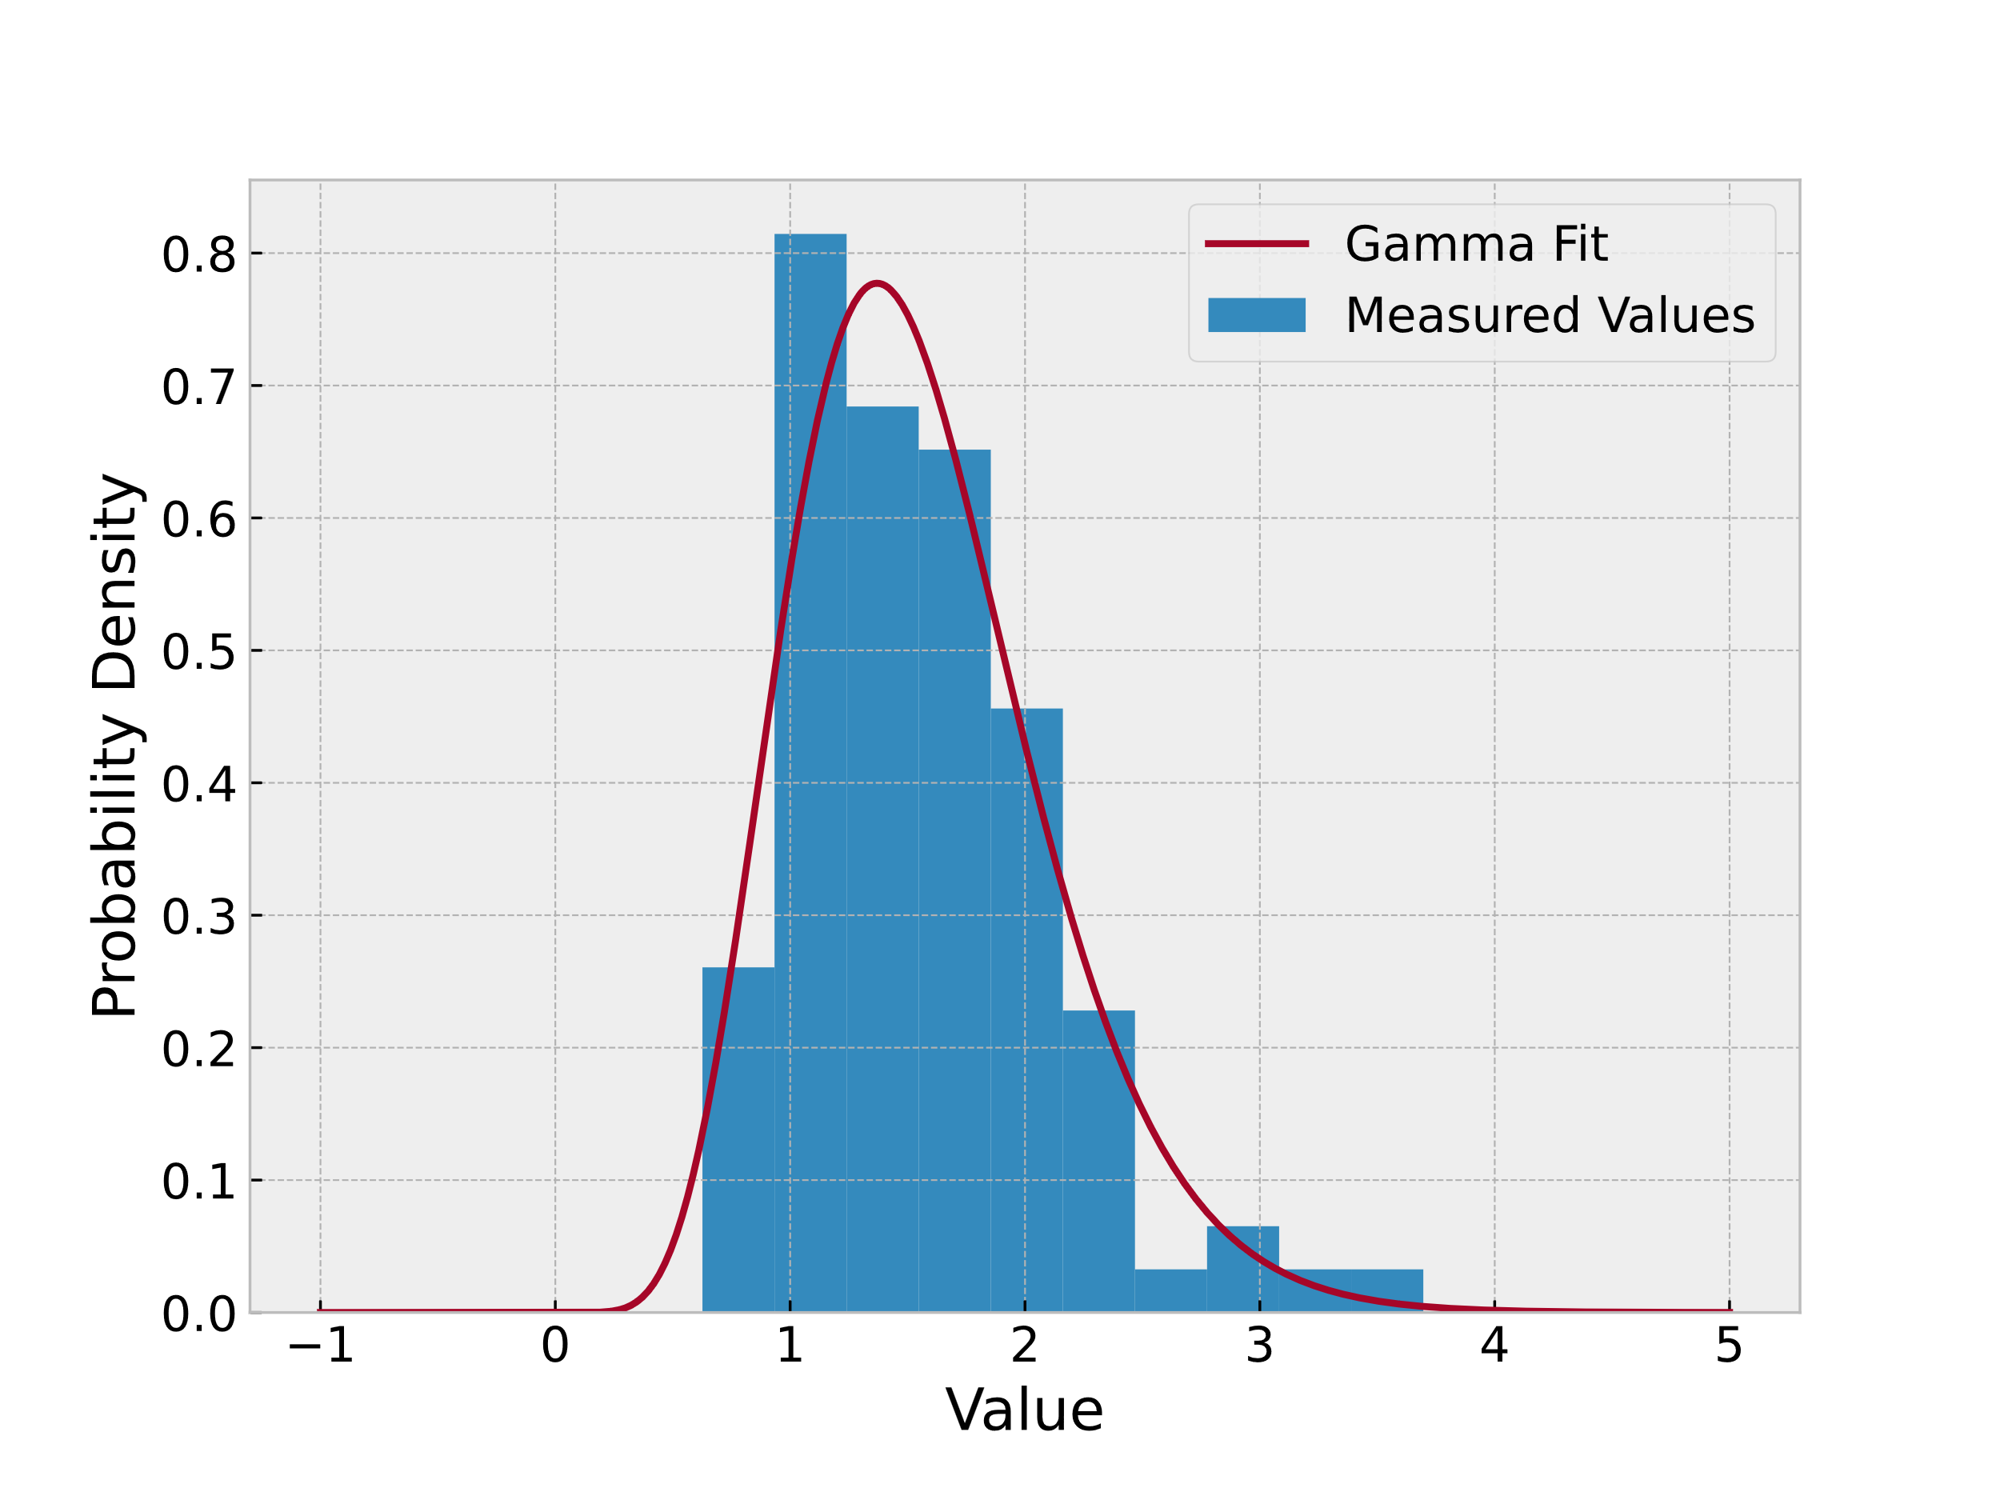
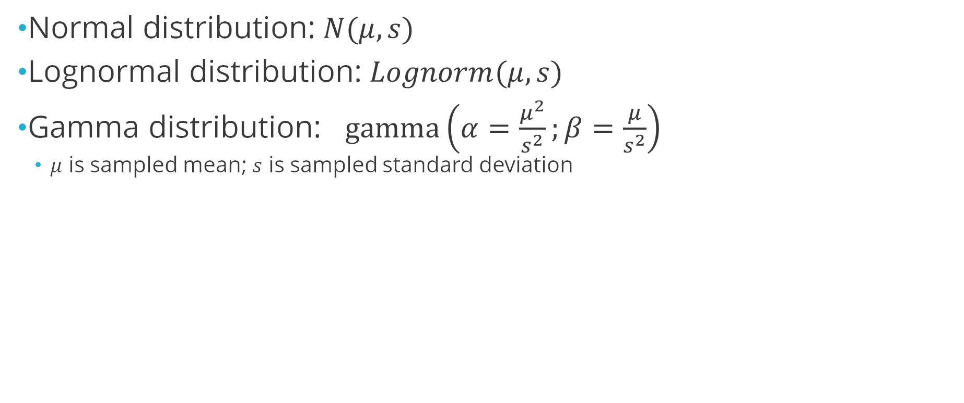
Distribution Fitting
Normal distribution: $N(μ, s)$
Lognormal distribution: $Lognorm(μ, s)$
Gamma distribution: $gamma\left(α=\frac{μ^{2}}{s^{2}};β=\frac{μ}{s^{2}}\right)$
$μ$ is sampled mean; $s$ is sampled standard deviation

Slide 55
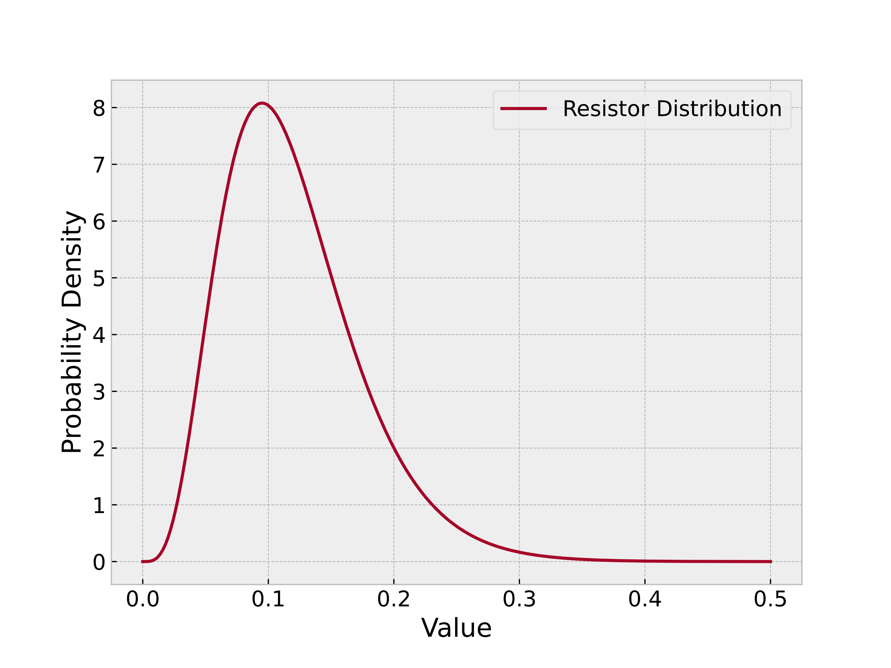
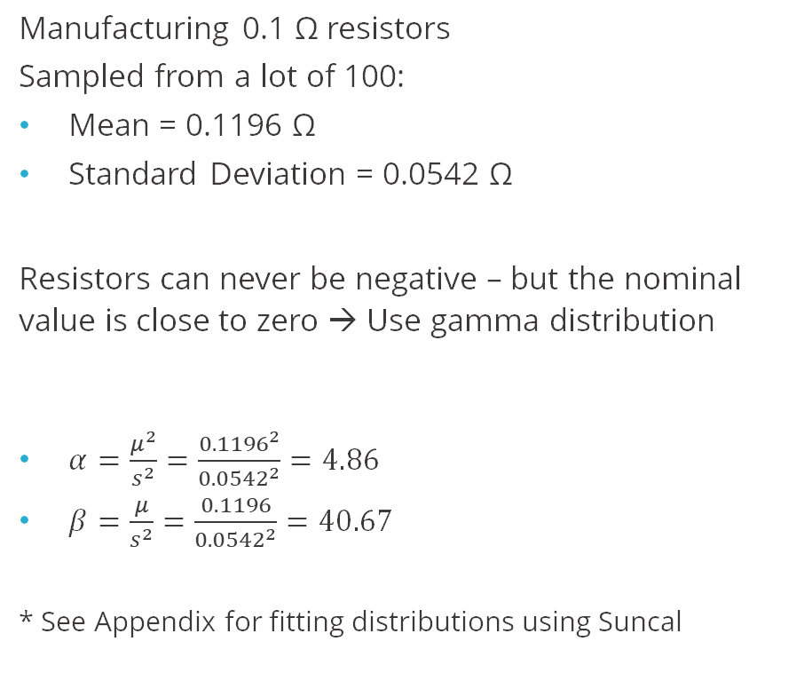
Example – Distribution Fit From Manufacturing Data
Manufacturing 0.1 Ω resistors
Sampled from a lot of 100:
Mean = 0.1196 Ω
Standard Deviation = 0.0542 Ω
Resistors can never be negative – but the nominal value is close to zero → Use gamma distribution
$α=\frac{μ^{2}}{s^{2}}=\frac{{0.1196}^{2}}{{0.0542}^{2}}=4.86$
$β=\frac{μ}{s^{2}}=\frac{0.1196}{{0.0542}^{2}}=40.67$
* See Appendix for fitting distributions using Suncal
Notes:
Recall that if your values can never be negative, a normal distribution is usually not the way to go

Slide 56
Question
T/F
The following distribution should be treated as a normal distribution if it demonstrates a distribution of resistance measurements?
Notes:
F.

Slide 57
Section 4 Simplified Risk Metrics
Test Uncertainty Ratios

Slide 58
Section 4 – Simplified Risk Metrics
Objective
Define test uncertainty ratio and show how it relates to false accept and reject risk.
Content
Information Requirements
Test Uncertainty Ratio
TUR Assumptions
Risk Curves

Slide 59
Information Requirements
Tolerance Limits (engineering/design)
Measurement distribution (measurement uncertainty analysis – GUM)
Product distribution (knowledge of manufacturing or calibration process)
Between the need for detailed information, combined with the messy PFA and PFR integrals (historically difficult to solve), some simplified metrics for quantifying risk have been developed.
Notes:
We've been doing it the hard way (calculus) now we get to do it the easy way

Slide 60
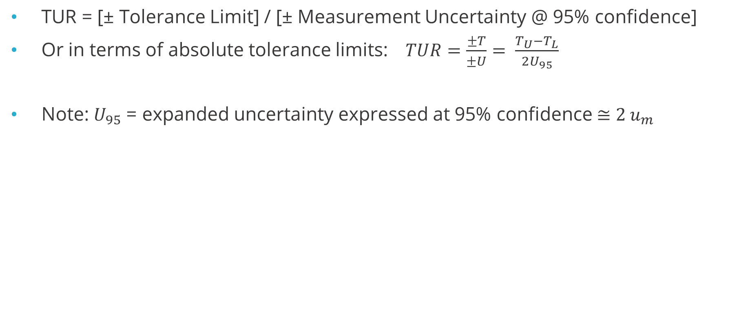
Test Uncertainty Ratio
TUR = [± Tolerance Limit] / [± Measurement Uncertainty @ 95% confidence]
Or in terms of absolute tolerance limits: $TUR=\frac{±T}{±U}= \frac{T_{U}−T_{L}}{2U_{95}}$
Note: $U_{95}$ = expanded uncertainty expressed at 95% confidence ≅ $2 u_{m}$
Notes:
Introduce the TUR – say when we use it
Use TAR when you don’t have a full evaluation of measurement uncertainty (e.g. when evaluating which new equipment to purchase)
U95 = 2um assumes k=2 results in 95% coverage. Always want denominator in TUR to be 95% coverage, regardless of any student-t adjustment to k.
In some cases, risk integral should be solved with Student-T distribution rather than normal.

Slide 61
TAR or TUR?
Most common definitions found in literature:
TUR = [± Tolerance Limit] / [± Measurement Uncertainty @ 95% confidence]
TAR = [± Tolerance Limit] / [± Equipment Accuracy Only @ 95%]
9900000 and PSLM:
TAR = product characteristic tolerance divided by the collective measurement uncertainty of the equipment based on a confidence level of 95% or better [99M]
TUR = certification tolerance of device being calibrated divided by process uncertainty of the process used to calibrate [PSLM]
JCGM 106:
“Care has to be taken when such [TAR or TUR] rules are encountered because they are sometimes ambiguously or incompletely defined.”
Measurement Capability Index = [± Tolerance Limit] / [± Measurement Uncertainty @ 95%]

Slide 62
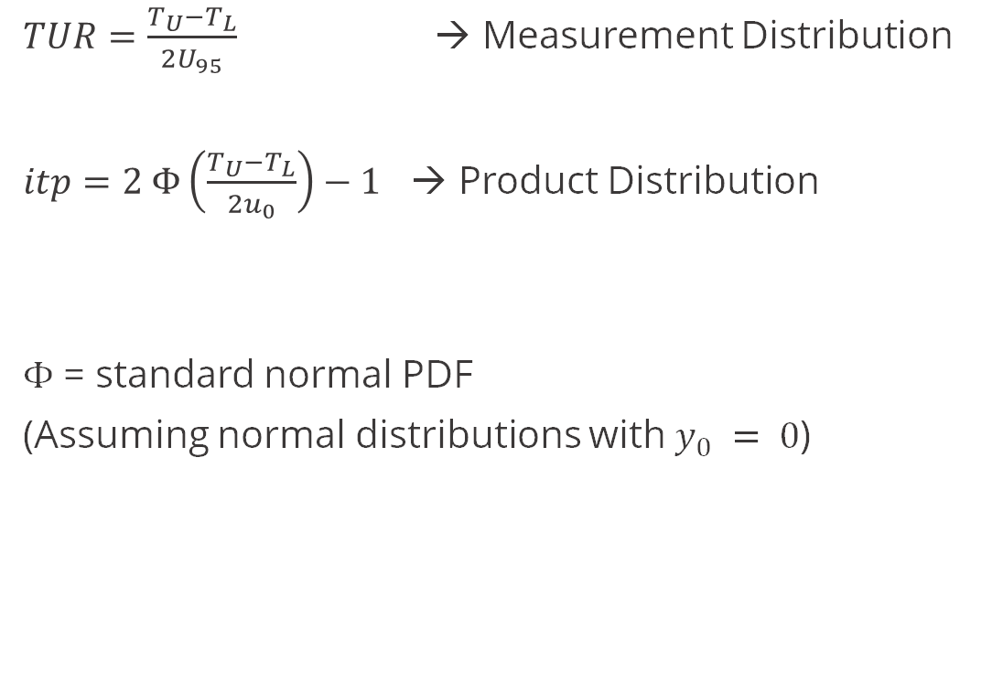
What does TUR have to do with risk?
$TUR=\frac{T_{U}−T_{L}}{2U_{95}}$ → Measurement Distribution
$itp=2 Φ\left(\frac{T_{U}−T_{L}}{2u_{0}}\right)−1$ → Product Distribution
$Φ$ = standard normal PDF
(Assuming normal distributions with $y_{0} = 0$)
TUR
ITP distribution
Notes:
TUR is making a simplification of the PFA integral that we saw before.
It is related to the risk by the ratio.
The integral had 6 variables in it, and we have simplified that into 2, by looking at it in terms of ratio.
TUR tells you how stretched it is up and down
ITP has 2 limits and the product uncertainty, width of product dist. ITP tells us how wide it is left to right.

Slide 63
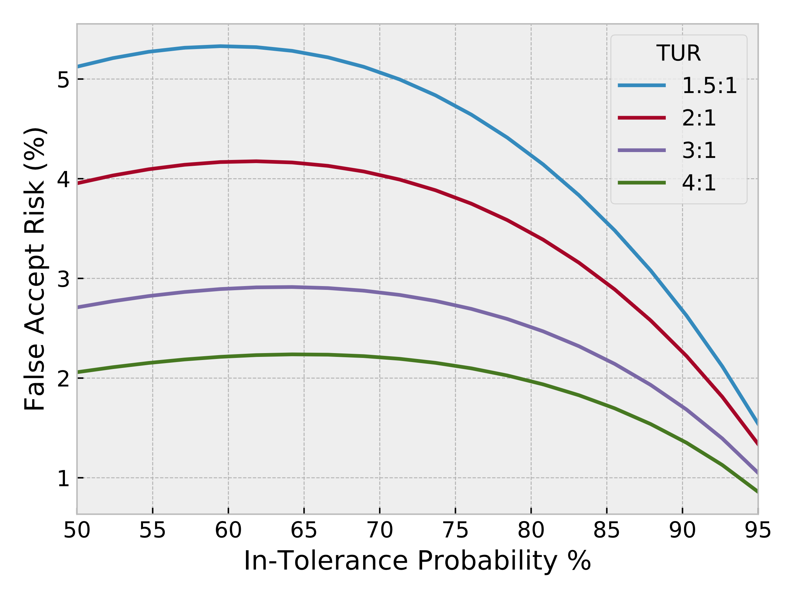
PFA versus TUR and itp – why we use 4:1 “rule”
TUR and 𝑖𝑡𝑝 condense all the required knowledge into two ratios
PFA is always less than 2% for all TUR bigger than 4, given a typical 𝑖𝑡𝑝 above 80%.
Notes:
Now we can plot the 6 variables on 2 axis!
The green curve crosses 2 (y axis) and 80 (x axis)

Slide 64
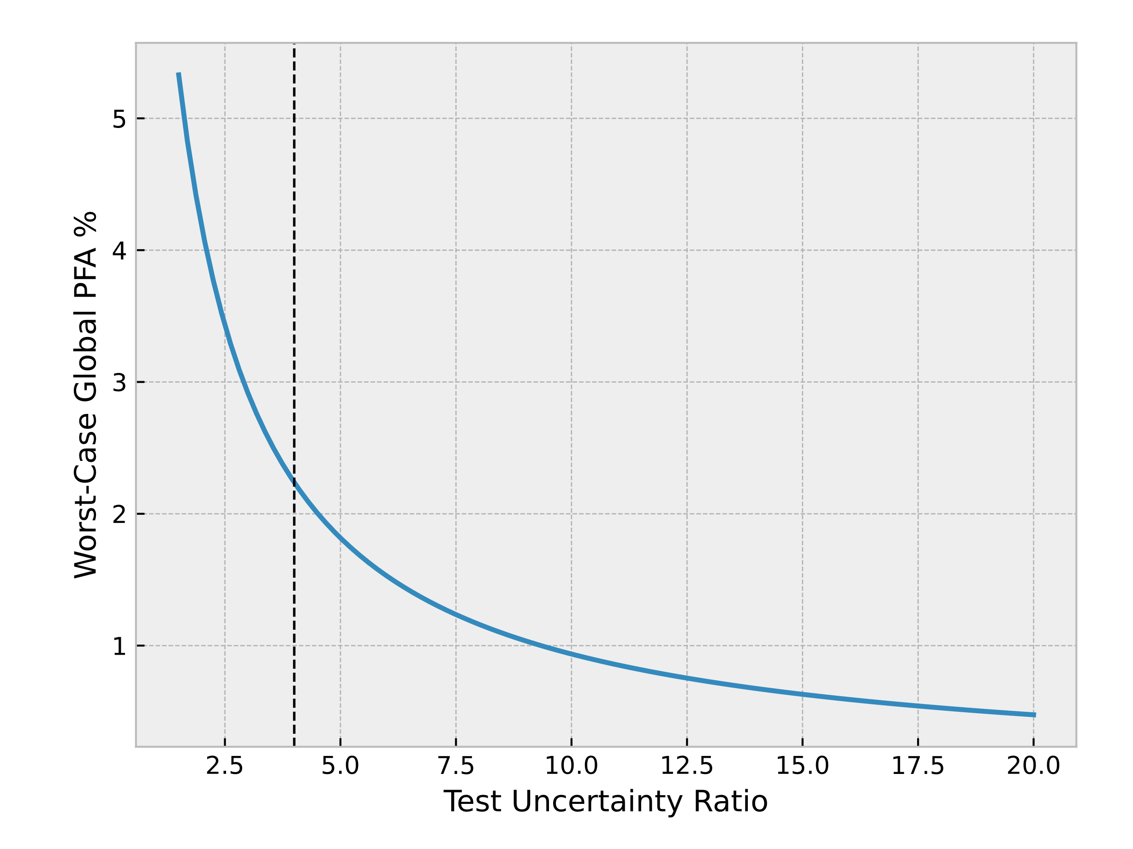
TUR and worst-case PFA
Extract the peaks along each TUR from the previous graph…

Slide 65
Historical Note
From Scott Mimbs (NASA), Measurement Decision Risk: The Importance of Definitions. NCSLI Workshop & Symposium, 2007:
“In the mid-50's, computing consumer risk was a very arduous task (requiring use of a slide rule), which [Jerry] Hayes decided not to require U.S. Navy contractors to perform.”
“The [Navy’s] practice at the time was to use a 10:1 ratio, but that value was considered unsupportable by the nation’s calibration support and measurement traceability infrastructure…”
“A consumer risk of 1% was selected, which calculated to be about a 3:1 accuracy ratio … decided to pad the ratio … thus the 4:1 ratio requirement was developed and established as Navy policy.”
“NASA used the 10:1 for all calibration requirements through the first moon landing in 1969. After that, calibration requirements were changed to 4:1 while test measurement requirements remained at 10:1.”
“When Hayes allowed the use [of TUR]… the idea was supposed to be temporary until better computing power became available…”
Notes:
Mimbs’s citation for the choice of 1% is “a series of telephone interviews” with Hayes, so we have no historical knowledge or justification for this particular value of PFA.
Jerry Hayes was founder and director of the Navy’s metrology and calibration program.
These concepts were developed in the 1950s and they didn't want to do the double integrals. They invented TUR and settled on a 4:1 ratio

Slide 66
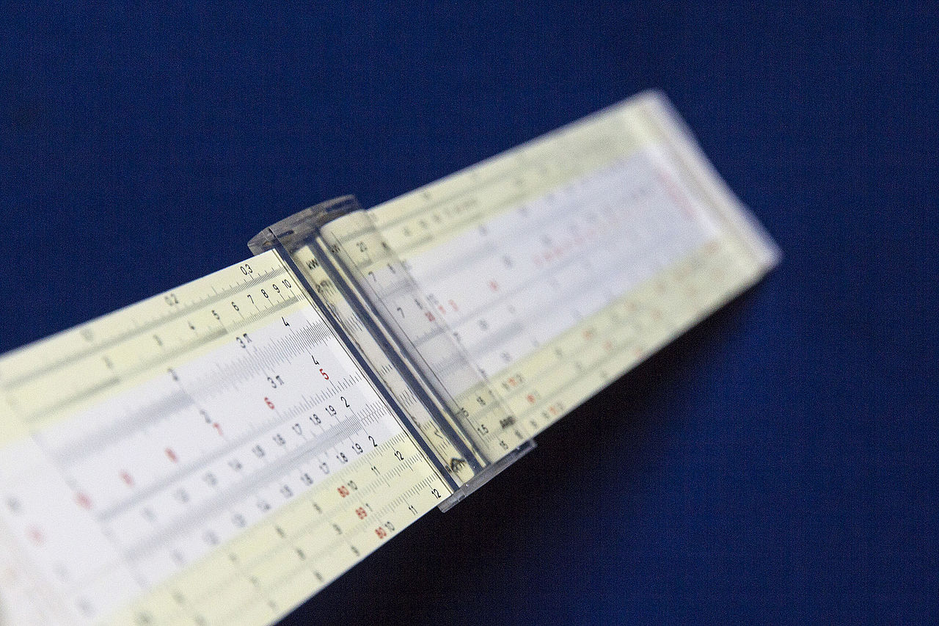
Now we have two risk calculation tools
TUR as a quick metric for simple risk evaluation
Software for full false accept false reject evaluation
Jan1959/CC BY-SA 4.0
Sandia Uncertainty Calculator
It’s 2025 – Computing power is just a bit better than it was in 1955.
Notes:
Apollo mission lol

Slide 67
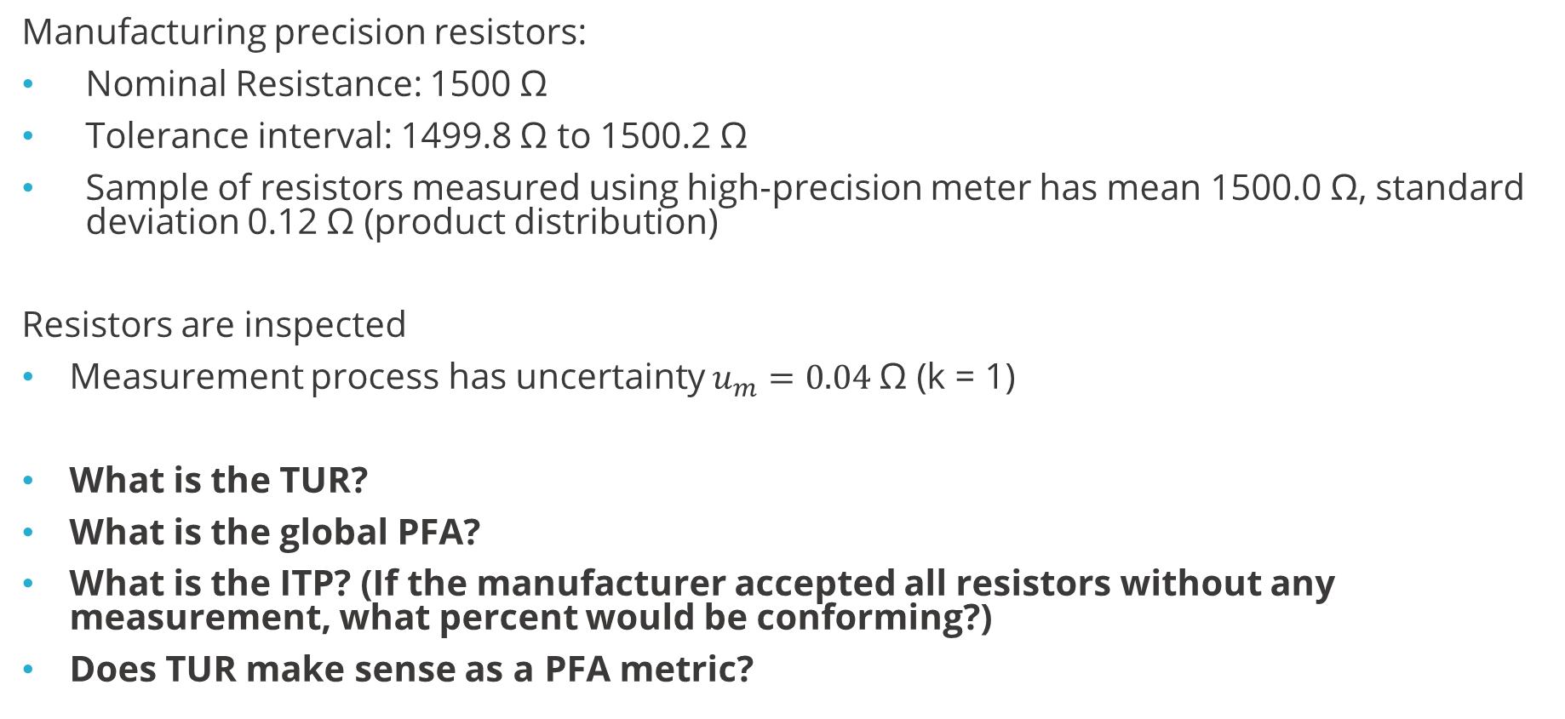
Exercise – Resistor Example JCGM106 9.5.3 (page 27)
Manufacturing precision resistors:
Nominal Resistance: 1500 Ω
Tolerance interval: 1499.8 Ω to 1500.2 Ω
Sample of resistors measured using high-precision meter has mean 1500.0 Ω, standard deviation 0.12 Ω (product distribution)
Resistors are inspected
Measurement process has uncertainty $u_{m}=0.04 \text{Ω}$ (k = 1)
What is the TUR?
What is the global PFA?
What is the ITP? (If the manufacturer accepted all resistors without any measurement, what percent would be conforming?)
Does TUR make sense as a PFA metric?

Slide 68
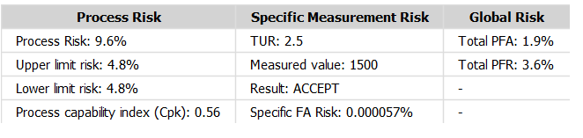
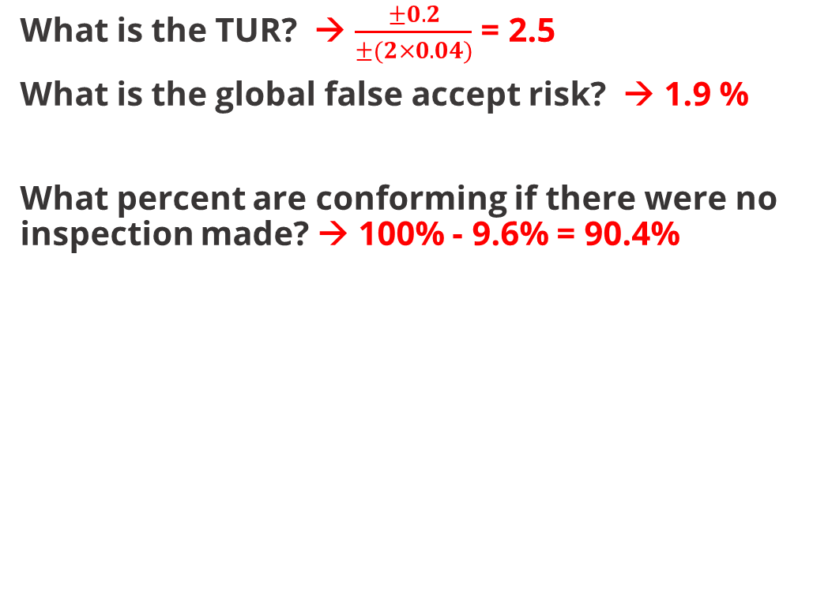
Resistor Example – Add a screening process
What is the TUR? → $\frac{±0.2}{±(2×0.04)}$ = 2.5
What is the global false accept risk? → 1.9 %
What percent are conforming if there were no inspection made? → 100% - 9.6% = 90.4%

Slide 69
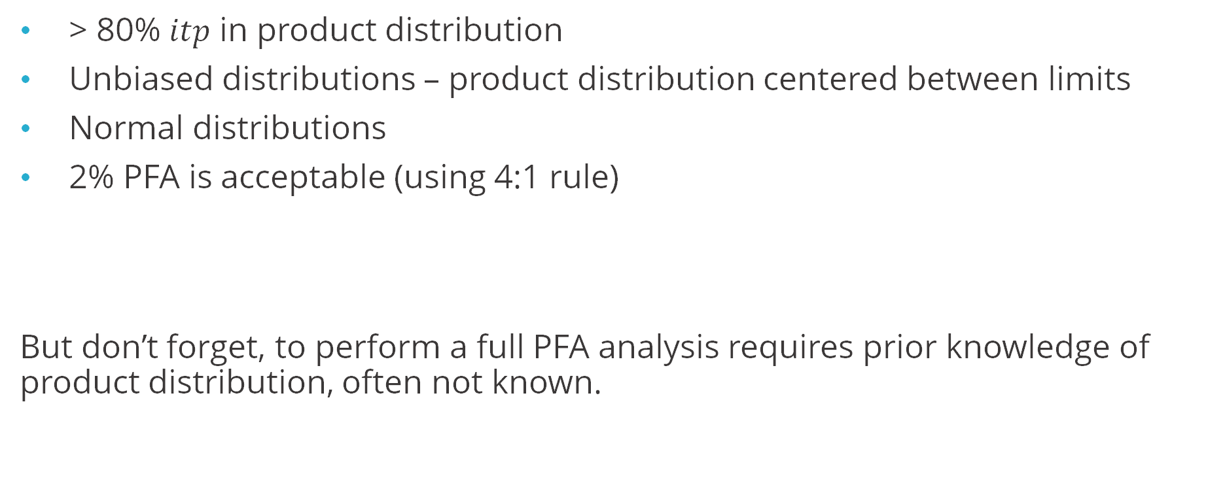
TUR makes some assumptions. Are they justified?
> 80% $itp$ in product distribution
Unbiased distributions – product distribution centered between limits
Normal distributions
2% PFA is acceptable (using 4:1 rule)
But don’t forget, to perform a full PFA analysis requires prior knowledge of product distribution, often not known.

Slide 70
TUR assumptions
Likelihood Tier | Consequence Tier
 | Catastrophic | Severe | Moderate | Low | Negligible
Very High | VH | VH | H | M | L
High | VH | H | M | M | L
Moderate | H | M | M | L | L
Low | M | M | L | L | N
Negligible | L | L | L | N | N
TUR > 4 “rule” says 2% likelihood is ok…
But TUR doesn’t know about consequence tier…
Notes:
TUR is only about likelihood, it doesn't talk about consequence.

Slide 71
Section 5 Risk Management
Guardbanding to mitigate risk

Slide 72
Section 5 – Risk Management
Objective
Discuss and analyze guardbanding methods used for reducing false accept risk.
Content
Guardbanding
Risk evaluation with guardband
Guardband methods

Slide 73
Four ways of reducing false accept risk
Reduce measurement uncertainty ($)
Improve process control ($$)
Convince design engineers to relax the tolerance (??)
Apply guardbanded acceptance limits

Slide 74
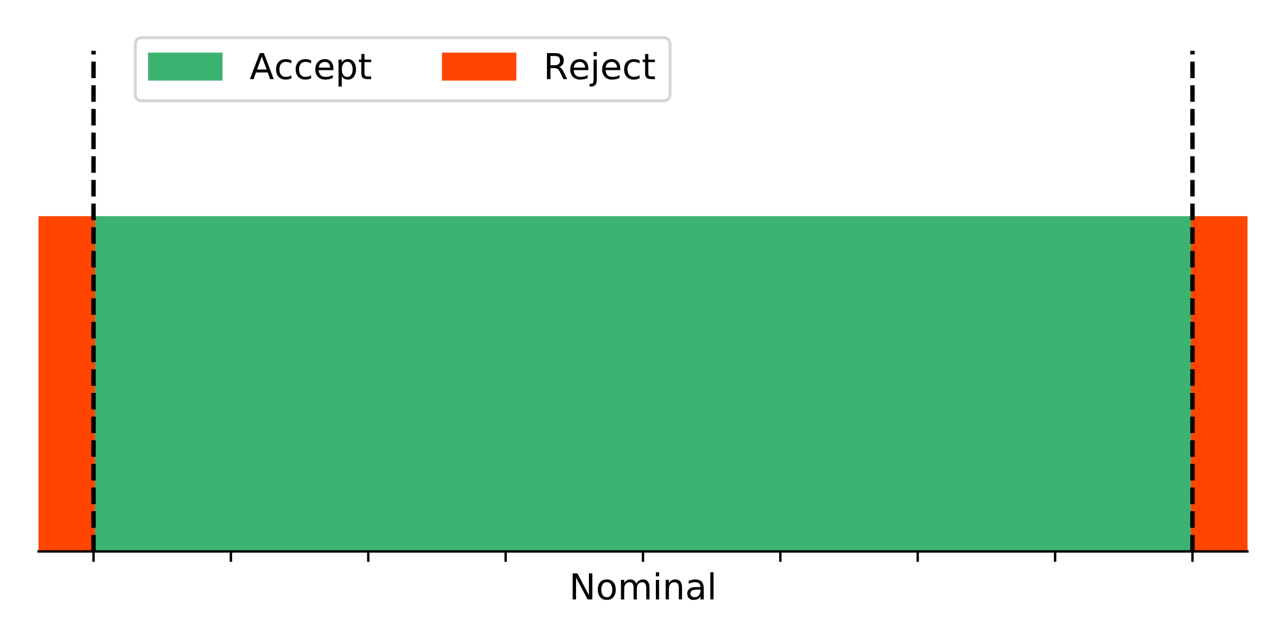
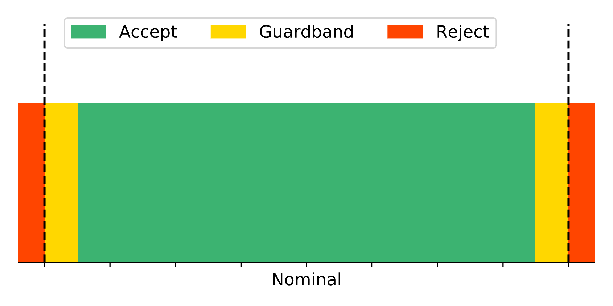
Guardbanding defines acceptance limits lower than tolerance limits
Typical rule: Apply guardband if TUR < 4
Determine Acceptance Limits A_{L} and A_{U}
Parts measuring in the green are accepted
Parts measuring in yellow are rejected, even though the measured value indicates it is within tolerance
T_{L}
T_{U}
T_{L}
T_{U}

Slide 75

Guardband factor is the multiplier used to reduce tolerance limits
New acceptance limit = Original limit × guardband factor
With Symmetric Limits
$± A =± T ×GBF$
Or in terms of non-symmetric limits:
$A_{L}=T_{L}+\left(1−GBF\right)\left(\frac{T_{U}−T_{L}}{2}\right)$
$A_{U}=T_{U}−(1−GBF)\left(\frac{T_{U}−T_{L}}{2}\right)$

Slide 76



Guardbanded Risk – calculated from same integrals with modified limits
$$\begin{aligned}& \\ PFA=\int_{−∞}^{T_{L}}{\int_{A_{L}}^{A_{U}}{p_{m}\left(t−y\right) p_{p}\left(t\right) dy}dt+\int_{T_{U}}^{+∞}{\int_{A_{L}}^{A_{U}}{p_{m}\left(t−y\right) p_{p}\left(t\right) dy}dt}}\end{aligned}$$
$$\begin{aligned}& \\ PFR=\int_{T_{L}}^{T_{U}}{\int_{−∞}^{A_{L}}{p_{m}\left(t−y\right)} p_{p}\left(t\right) dy dt+\int_{T_{L}}^{T_{U}}{\int_{A_{U}}^{+∞}{p_{m}\left(t−y\right)} p_{p}\left(t\right) dy dt}}\end{aligned}$$
$p_{m}$= Measurement PDF
$p_{p}$= Product PDF
$y$ = Measured Value
$t$ = Possible True Values
$T_{L}$, $T_{U}$ = Lower and Upper Tolerance Limits
$A_{L}$, $A_{U}$ = Lower and Upper Acceptance Limits

Slide 77


Guardbanded Risk – visualized using Monte Carlo
No Guardband
Guardband
Notice the tradeoff between PFA and PFR!

Slide 78

Common guardbanding methods
Most methods for calculating an appropriate guardband are based on TUR
RSS Method
$GBF= \sqrt{1−1/TUR^{2}}$
$U_{95}$ Method
$GBF = 1 – 1/TUR$
Equivalent to $A =T –U_{95}$; subtract the 95% measurement uncertainty
“Method 5” in NCSLI’s Handbook to Z540.3
“Method 6” :
GBF = $1 – M_{2}/TUR$
$M_{2}=1.04 −\exp\left(0.38\ln\left(TUR\right)−0.54\right)$
Guaranteed PFA < 2% for any ITP and TUR combination
“Method 6” in NCSLI’s Handbook to Z540.3
Target a desired PFA
Reverse the PFA integrals and solve for A_{L}, A_{U} that result in the desired PFA.
“Method 1” and “Method 2” in NCSLI’s Handbook to Z540.3
Notes:
“Method 3” – considers conditional PFA
“Method 4” – Bayesian approach

Slide 79

Resistor Example continued with guardbanding
Use Suncal’s guardband calculator to try different methods

Slide 80

Guardbanding comments and recommendations
Use the RSS Method when:
Need an easy to remember equation
Calculations are done by hand or in Excel
Use Method 6 (Dobbert’s Equation) when:
Calculations are all performed in automated software
OR if a PFA other than 2% is desired (rederive the coefficients)
NOTE: this method will set A > T (accepting products outside the limits) if TUR > ~4.5!
Use $U_{95}$ (Method 5) when:
You don’t like math and are ok with huge PFR
Need to be extra-conservative
You have a true one-sided limit and unknown product mean, where TUR is not defined
Use Target PFA method when:
An exact PFA is desired, and fairly high PFR is acceptable.
Computing power and software is available
Another option:
Minimize total expected cost of false accept and false reject (see Easterling’s papers)

Slide 81
Which is more important - Global Risk vs. Specific Risk?
The above guardbanding methods all work to reduce global risk. A guardband could also be computed to allow a maximum specific risk.
Consider specific risk as the “important number” when:
No history or prior knowledge of unit being measured
Cost of false accept far exceeds cost of false reject (need to be conservative)
Consider global risk when:
Prior knowledge can be assumed on unit being measured
Process is in tight control (very high ITP)
Notes:
Z540.3’s 2% rule is vague on this – most people interpret it to be 2% global PFA, but some have assumed it to be specific risk, or conditional risk (ie 2% of accepted products instead of 2% of all products).

Slide 82
Unconditional Risk vs. Conditional Risk?
 | Accepted | Rejected | Total
In Tolerance | 83 | 7 | 90
Out of Tolerance | 1 | 9 | 10
Total | 84 | 16 | 100
Of ALL the parts that were made:
PFA = 1 / 100 = 1.0% → P(OOT, Accept), unconditional false accept risk
PFR = 7 / 100 = 7.0% → P(IT, Reject)
Of the parts DELIVERED to the customer:
Conditional PFA (CPFA) = 1 / 84 = 1.2% → P(OOT | Accept)
Conditional PFR (CPFR) = 7 / 16 = 44% → P(IT | Reject)
Note: Typical guardband methods are designed to control unconditional PFA.
Customers may be more concerned with CPFA. CPFA is always greater than PFA!
Notes:
Ref: NCSLI RP-18 for more discussion on conditional risk probabilities.

Slide 83
Question
T/F
The traditional RSS guardbanding equation is:
1-1/TUR

Slide 84
Section 6 When TUR doesn’t work
One-sided limits, non-normal or biased distributions, etc.

Slide 85
Section 6 – When TUR doesn’t work
Objective
Discuss options for guardbanding and risk mitigation when TURs assumptions break down
Content
TUR Assumptions
One-sided tolerances
Non-normal or biased distributions
Exercise

Slide 86

Recall the assumptions made by TUR and 4:1 rule
> 80% $itp$ in product distribution
Unbiased distributions – product distribution centered between two limits
Normal distributions
2% PFA is acceptable (using 4:1 rule)

Slide 87


One-sided tolerances
Cannot calculate TUR = $(T_{U}−T_{L})/2U_{95}$.
No simple way to assume product distribution $y_{0}$ and $u0$
Typical solution when product distribution is unknown: use $U_{95}$ guardbanding on single-sided limit: $A=T −U_{95}$
?

Slide 88


One-sided tolerances – Traditional U₉₅ can be overly conservative
U₉₅ Guardband
Target 0.8% Guardband
Notes:
One-sided limits typically don’t want to make any assumptions about where the process distribution lies with respect to the limit. If that information is known, it can be used to achieve a more appropriate acceptance limit.

Slide 89

Assuming T_{L} = 0 is dangerous!
$TUR= \frac{T_{U}−T_{L}}{2U_{95}}$
$ITP=2 Φ\left(\frac{T_{U}−T_{L}}{2u_{0}}\right)−1$
Maximum limit; set $T_{L}= 0$?
Assumes average product is exactly half the limit
False Reject
Assumes product will fall below zero with the same probability they fall above the maximum limit
False Accept
The implied zero limit does not result in a valid representation of products, so this TUR with T_{L}=0 is not a valid representation of risk!

Slide 90


One-sided Option 1: Always apply U₉₅ Guardbanding
Acceptance Limit $A_{U}=T_{U}−U_{95}$
or $A_{L}=T_{L}−U_{95}$
(Subtract off the uncertainty)
Does not consider DUT population, so can be overly conservative (high false rejects)
Does not make any assumptions about DUTs.
Only allowed option per earlier version of 9900000

Slide 91


One-sided Option 2: Reduced U95 Guardband
Acceptance Limit $A_{U}=T_{U}−{0.871 U}_{95}$
or $A_{L}=T_{L}+{0.871 U}_{95}$
Not as overly-conservative as U95 method.
Results in < 2% PFA when process mean is within the tolerance.
Considers this as worst-case
9900000 AU and R028: Not explicitly included, but satisfies the general 2% requirements

Slide 92



One-sided Option 3: Use a modified TUR > 4 rule
Calculate TUR by using a known DUT population mean:
$$TUR= \frac{T_{U}−y_{0}}{U_{95}}$$
$k_{m}= \frac{T_{U}−y_{0}}{u_{0}}$,
Number of standard deviations between the tolerance and DUT population mean (because one-sided ITP can’t be calculated either)
9900000 AU and R028: Added as a new option

Slide 93

One-sided Option 4: Just do the calculus
If $y_{0}$ is known, $u_{0}$ is probably known too (via sampling the population).
You have everything you need to just solve* for the ideal guardband directly…
$$PFA=2\%=\int_{T_{U}}^{+∞}{\left(\int_{−∞}^{A_{U}}{{\frac{1}{u_{m}\sqrt{2π}}e}^{−{\frac{1}{2u_{m}^{2}}\left(y−t\right)}^{2}}dy}\right){\frac{1}{u_{0}\sqrt{2π}}e}^{−{\frac{1}{2u_{0}^{2}}\left(t−y_{0}\right)}^{2}}dt}$$
*Suncal software can do the math for you.
**This is really the best option for all guardband calculations, not just with one-sided limits. It’s not the 1950s anymore – we can use computers to do math!
9900000 AU and R028: Added as a new option

Slide 94


Non-normal distributions
When either distribution is not normal/gaussian, use the proper PDF in the PFA/PFR equations:
$$PFA=\int_{−∞}^{T_{L}}{\int_{T_{L}}^{T_{U}}{p_{m}\left(t−y\right) p_{p}\left(t\right) dy}dt+\int_{T_{U}}^{+∞}{\int_{T_{L}}^{T_{U}}{p_{m}\left(t−y\right) p_{p}\left(t\right) dy}dt}}$$
See “Evaluating Risk in an Abnormal World”, NCSLI Measure, 13.2 (2020).
 | Specific Risk Calculated Using:
Limit | Normal PDF (GUM) | Histogram PDF (MC)
< 900 nm | 0.90% | 2.97%

Slide 95


Biased product distributions
When the product distribution is not centered between the limits, traditional guardbanding methods do not achieve the same level of risk!
See “A Guardbanding Method for Managing False Accept Risk under Process Bias”, NCSLI Measure, 15.1 (2023).
R028: Added “bias-managed method” as a new option (Appendix H 3.c)

Slide 96
Exercise – Ball Bearings (JCGM106 9.5.4)
Manufacturing precision ball bearings. Radial error motion must be less than 2 μm
A perfect bearing has 0 radial error motion
Process characterized by sampling: mean 1 μm; standard deviation 0.5 μm.
Each bearing measured with standard uncertainty 0.25 μm (normal distribution)
Maximum allowed PFA is 0.1%.
Questions to get started:
What are the tolerance limits?
What is the TUR? Does TUR make sense?
What PDF should be used for product distribution?

Slide 97

Exercise – Ball Bearings (JCGM106 9.5.4)
Because radial error motion can never be negative, but process is close to zero, a gamma distribution can be used. (See JCGM106 B.3)
Lower limit is implied at 0.
TUR does not apply! (Distribution is gamma, customer requires 0.1% PFA max)
Gamma Distribution:
$$α=\frac{μ^{2}}{s^{2}}= \frac{1 μm^{2}}{0.5 μm^{2}}=4$$
$$β=\frac{μ}{s^{2}}= \frac{1 μm}{0.5 μm^{2}}=4$$

Slide 98
Exercise – Ball Bearings (JCGM106 9.5.4)
Requirement: < 2 μm
Process sampled: mean 1 μm; standard deviation 0.5 μm.
Gamma distribution, α = 4, β = 4
Measurement uncertainty: 0.25 μm (normal distribution, k = 1)
Maximum allowed PFA is 0.1%.

Slide 99

Exercise – Ball Bearings (JCGM106 9.5.4)

Slide 100

Exercise – Ball Bearings (JCGM106 9.5.4)
Use the PFA guardband method target the required PFA of 0.1%.

Slide 101
Wrap-Up

Slide 102
Decision Rules
A “decision rule” is a formal statement of how a decision is made, taking into account measurement uncertainty and risk. Examples:
Simple Acceptance: Accept any product measuring within the limits
Guarded Acceptance: Accept products within reduced limits applied when TUR < 4.
Other options:
Conditional Acceptance: Products within the guardband are “undetermined”
Nonbinary Rules: Products that are too big can be sent back for rework, products too small must be scrapped
All decision rules must be agreed upon between the metrology organization and customer

Slide 103
9900000 AU Options (Effective January 2024)
Test Accuracy Ratio (TAR) based evaluation Clarified calculation, +examples
Two-sided Tolerances No Change
One-sided Tolerances Defined TAR-based options
Specification of acceptance equipment in drawing Clarifications
Direct evaluation of false accept risk New option

Slide 104
R028 Options (Effective August 2025)
Appendix H lists options for achieving 2% global PFA (or 1% if working at 95% ITP):
Calculate global PFA directly and ensure < 2%
Ensure worst-case specific risk is less than 2% (always apply U95 guardband)
TUR > 4
1.5 < TUR < 4 with RDS guardband
One-sided tolerance “modified TUR”
Biased guardband table (option 3.c) – Always guardbands but works with bias

Slide 105
Back to Measurement Assurance Plans
Use TUR if its assumptions are justified
If not, evaluate false accept/reject and/or worst-case probability of conformance to determine if risk is acceptable
Q1. What quantity are you measuring? |  |  | Q2: How accurate do the measurements need to be? |  |  | Q3: How will you ensure your equipment can make this measurement?
Quantity Measured | MC | Requirement Number | Value or Range of Values Measured | Tolerance Limits | Guardbanded Acceptance Limit | Equipment Used (M&TE) | Measurement Uncertainty | TUR (>4 desired) | Calibrate (Yes/No)

Slide 106

Bottom line
How you evaluate risk and assign acceptance limits all depends on what data is available and how much risk, either global or specific, is acceptable for the given application.
Coming soon: PSL’s “Smart MAP” Excel Template that calculates PFA and PFA-target guardbands right in your MAP!

Slide 107
References
Evaluation of measurement data – the role of measurement uncertainty in conformity assessment. JCGM 106:2012.
S. Crowder, C. Delker, E. Forrest, N. Martin. Introduction to Statistics in Metrology. Springer, 2020.
M. Dobbert. A guard-band strategy for managing false accept risk. NCSL Workshop & Symposium 2008.
M. Dobbert. Understanding measurement risk. NCSL Workshop & Symposium 2007.
R. Stern, J. Harben. Decision rule reporting to comply with ISO/IEC 17025. NCSL Workshop & Symposium 2017.
D. Deaver. How to maintain your confidence in a world of declining test uncertainty ratios. NCSL Workshop & Symposium 1993.
R. Easterling, M. Johnson, T. Bement, C. Nachtsheim. Statistical tolerancing based on consumer’s risk considerations. Journal of Quality Technology, 23(1), 1991.
S. Mimbs. Using reliability to meet Z540.3’s 2% rule. NCSL Workshop & Symposium 2011.
S. Mimbs. Measurement decision risk – the importance of definitions. NCSL Workshop & Symposium 2007.
SLR Ellison, A. Williams. EURACHEM/CITAC Guide: Use of uncertainty information in compliance assessment. 2007.
C. Delker. Evaluating Risk in an Abnormal World. NCSLI Measure 13.2, 2021.
“Estimation and Evaluation of Measurement Decision Risk”. NCSLI Recommended Practice 18, 2014.
“Handbook for Application of Z540.3-2006”, NCSL International, 2009.
Guidelines on Decision Rules and Statements of Conformity. ILAC-G8:09/2019

Slide 108

Variables Glossary
$T_{U}:$ Upper tolerance limit
$T_{L}:$ Lower tolerance limit
$A_{U}:$ Upper acceptance limit
$A_{L}:$ Lower acceptance limit
$p_{m}$: Probability density function of measurement
$p_{p}$: Probability density function of products (prior knowledge)
$y_{0}:$ Mean of product distribution
$u_{0}:$ Standard deviation of product distribution
$u_{m}:$ Standard deviation of measurement distribution
$y$: Measured Value
TUR: Test Uncertainty Ratio = $\frac{T_{U}−T_{L}}{2U_{95}}=\frac{T_{U}−T_{L}}{4u_{m}}= \frac{±T}{±U_{95}}$
$itp$: In-tolerance probability
$U_{95}$: Expanded (95% coverage) measurement uncertainty

Slide 109
Appendix A Equation Variations
Differences in notation used in various publications

Slide 110



JCGM106 Eq. 19 and 20 with normal distributions substituted
$$\begin{aligned}&PFA=\int_{−∞}^{T_{L}}{\left(\int_{A_{L}}^{A_{U}}{{\frac{1}{u_{m}\sqrt{2π}}e}^{−{\frac{1}{2u_{m}^{2}}\left(y−t\right)}^{2}}dy}\right){\frac{1}{u_{0}\sqrt{2π}}e}^{−{\frac{1}{2u_{0}^{2}}\left(t−y_{0}\right)}^{2}}dt} \\ &+\int_{T_{U}}^{+∞}{\left(\int_{A_{L}}^{A_{U}}{{\frac{1}{u_{m}\sqrt{2π}}e}^{−{\frac{1}{2u_{m}^{2}}\left(y−t\right)}^{2}}dy}\right){\frac{1}{u_{0}\sqrt{2π}}e}^{−{\frac{1}{2u_{0}^{2}}\left(t−y_{0}\right)}^{2}}dt}\end{aligned}$$
$u_{m}$ = Standard Deviation of Measurement Unc.
$u_{0}$ = Standard Deviation of Product Dist.
$y_{0}$= Mean of Product Distribution.
$y$ = Measured Value
$T_{L}$, $T_{U}$ = Lower and Upper tolerance limits
$A_{L}$, $A_{U}$ = Lower and Upper acceptance limits
$$\begin{aligned}&PFR=\int_{T_{L}}^{T_{U}}{\left(\int_{−∞}^{A_{L}}{{\frac{1}{u_{m}\sqrt{2π}}e}^{−{\frac{1}{2u_{m}^{2}}\left(y−t\right)}^{2}}dy}\right){\frac{1}{u_{0}\sqrt{2π}}e}^{−{\frac{1}{2u_{0}^{2}}\left(t−y_{0}\right)}^{2}}dt} \\ &+\int_{T_{L}}^{T_{U}}{\left(\int_{A_{U}}^{+∞}{{\frac{1}{u_{m}\sqrt{2π}}e}^{−{\frac{1}{2u_{m}^{2}}\left(y−t\right)}^{2}}dy}\right){\frac{1}{u_{0}\sqrt{2π}}e}^{−{\frac{1}{2u_{0}^{2}}\left(t−y_{0}\right)}^{2}}dt}\end{aligned}$$
110
Notes:
See Excel sheet in supplemental material for a spreadsheet Monte Carlo evaluation of PFA.

Slide 111



JCGM106 Normal Probability Density and Distribution Functions
The normal probability density function for the measurand Y:
The probability of a normally distributed measurand Y is denoted by;
The normal distribution function is denoted by:
$$g(η|η_{m})=\frac{1}{u\sqrt{2π}}\text{exp}\left[−\frac{1}{2}\left(\frac{ξ−μ}{u}\right)\right]≔φ\left(η;y,u^{2}\right)$$
$$\operatorname{Pr}\left(a≤Y≤b | η_{m}\right)=Φ \left(\frac{b−y}{u}\right)−Φ \left(\frac{a−y}{u}\right)$$
$$Φ\left(z\right)=\frac{1}{\sqrt{2π}}\int_{−∞}^{z}{exp\left({−t^{2}}/2\right)dt}$$

Slide 112

JCGM106 Equations A.15 and A.16 (for normal distributions)
Equation A.15 in JCGM106 for false accept probability:
$$PFA=\int_{−∞}^{(T_{L}−y_{0})/u_{0}}{F\left(z\right)φ\left(z\right)dz+\int_{(T_{U}−y_{0})/u_{0}}^{∞}{F\left(z\right)φ\left(z\right)dz} }$$
Where $φ\left(z\right)= \frac{1}{\sqrt{2π}}exp⁡\left(−\frac{z^{2}}{2}\right)$,
$F\left(z\right)=Φ\left(\frac{A_{U}−y_{0}−u_{0}z}{u_{m}}\right)−$ $Φ\left(\frac{A_{L}−y_{0}−u_{0}z}{u_{m}}\right)$
$Φ(x)$ = standard normal distribution function = $\frac{1}{\sqrt{2π}}\int_{−∞}^{x}{e^{−t^{2}/2}dt}$
This equation is equivalent to equation 9. By changing variables, one integration was replaced with the $Φ$ function. May be slightly faster to execute in software that has efficient implementations of $Φ\left(x\right).$

Slide 113

Deaver's Equations for PFA and PFR (normal distributions)
Deaver's "How to Maintain Confidence" (1993) paper gives alternate equations for PFA and PFR (Eq 6 and 7) that also assumes normal distributions, but his paper uses different notation:
Deaver uses a different definition of TUR, and gives it the symbol R:
$R=u0/u_{m}$.
Specification limit is defined in terms of number of standard deviations of the process distribution:
$SL=(TU−y0)/u0$
Our $TUR =\frac{TU−T_{L}}{2U_{95}}=\frac{SL}{R}$.
Guardband Factor K:
$K=(AU−y0)/(TU−y0)$
$K=1$ means no guardband is applied.
$SL$ and $K$ assume $TU$ and $TL$ are symmetric about y₀.

Slide 114

Notation translator
 | JCGM 106 | Crowder | Dobbert | Deaver
Tolerance Limits | $$T_{L}, T_{U}$$ | $${SL}_{L}, {SL}_{U}$$ | $$±T$$ (Relative to 0) | $±SL∙σ$ (Tolerance defined as # stdevs from nominal)
Acceptance Limits | $$A_{L}, { A}_{U}$$ | $${AL}_{L}, { AL}_{U}$$ | $$±A$$ (Relative to 0) | $$±K∙SL∙σ$$ (Guradband factor K)
Product Mean | $$y_{0}$$ | $$μ_{p}$$ | 0 | 0
Product Std. dev. | $$u_{0}$$ | $$σ_{p}$$ | $$σ_{0}$$ | $$σ$$
Measurement Std. dev. | $$u_{m}$$ | $$σ_{m}$$ | $$σ_{m}$$ | $$σ/R$$ (R = $σ/σ_{m}$ is what Deaver calls TUR)
TUR | $$\frac{T_{U}−T_{L}}{4u_{m}}$$ | $$\frac{{SL}_{U}−{SL}_{L}}{4σ_{m}}$$ | $$T/{(2σ}_{m})$$ | $$SL/R$$ (Gives equivalent JCGM106 TUR in terms of Deaver’s notation)

Slide 115
Appendix B Additional Considerations
Potentially useful stuff we don’t have time for in a 4-hour class

Slide 116

Probability of Conformance using Microsoft Excel
Excel formula NORM.DIST computes the normal PDF.
One-sided (maximum) limit:
$p_{c}$= NORM.DIST(TU, y, um, TRUE) → probability of conformance (integrate below TU)
Two-sided limit:
$p_{c}$= NORM.DIST(TU, y, um, TRUE) – NORM.DIST(TL, y, um, TRUE)
The TRUE parameter tells it to compute the cumulative PDF (which does the integral)
T_{L}
T_{U}
y
u_{m}

Slide 117


Process Capability Index C_{pk}
Metric used to describe quality of process distribution (observed mean $y_{0}$ and std.dev. $u_{0})$. Related to $itp$. Measurement uncertainty is not considered.
If C_{pk} is high enough, risk is minimal regardless of measurement uncertainty
$C_{pk}=min⁡\left[\frac{T_{U}−y_{0}}{3u_{0}}, \frac{y_{0}−T_{L}}{3u_{0}}\right]$
Cpk | Sigma Level | Process Yield
0.33 | 1 | 68.27%
0.67 | 2 | 95.45%
1.00 | 3 | 99.73%
1.33 | 4 | 99.99%
1.67 | 5 | 99.9999%
2.0 | 6 | 99.9999998%

Slide 118

Guardbanding methods as described in NCSL’s Guide to Z540
Require numerical minimization techniques:
Method 1: Solve for PFA = 2%, at each test point
Method 2: Solve for PFA = 2%, at equipment level
Method 3: Solve for probability of false accept GIVEN acceptance result
Method 4: Bayesian statistics approach
Calculate by hand, Excel, etc. (analytical solution):
Method 5: Subtract 95% Uncertainty → $A =T –U_{95}$
Method 6: TUR-based, managed guardband (Dobbert’s Method)

Slide 119

Risk in 3D!
With RSS Guardbanding

Slide 120

Specific-Risk Guardbanding
Remember you can always have up to 50% specific risk?
If specific risk is a concern, or process distribution is unknown, can set guardband based solely on it.
Resistor Problem from JCGM 106 with Minimum Probability of Conformance set to 99%:

Slide 121

How guardband methods reduce risk differently

Slide 122
Appendix C Suncal Desktop Version Risk Calculations

Slide 123
Calculator Download (Desktop Version)
Download the latest version of the calculator from https://github.com/sandialabs/suncal/releases/latest
(v1.5.2+ required for this course, to use gamma distribution)
Files:
SandiaUncertCalc.exe – standalone Windows executable, no installation required
SandiaUncertCalc.zip – Same as above, but in zip format for download through restrictive firewalls
SandiaUncertCalcInstall.exe – installer for Windows. Runs a bit faster than above
SandiaUncertCalc-OSX-x.x.zip – Package for Mac OS
Suncalmanual.pdf – User’s manual
Examples.zip – Example uncertainty problems to load in to the calculator

Slide 124

Features
Given: Measurement model, output requirement, need input uncertainty
Use: Reverse Propagation
Given: Measurement model, input values and uncertainties
Use: Uncertainty Propagation
Given: 2-Dimensional data (e.g. N measurements ⨉ M days)
Use: Data Sets and ANOVA
Given: Measurement model, inputs could take several values
Use: Sweeps
Given: (x, y) data, need relationship between x and y
Use: Curve Fit
Given: Probability Distributions and tolerance limits
Use: Risk Analysis
Given: Probability Distributions to visualize
Use: Distribution Explorer
Given: Historical calibration pass/fail data
Use: Calibration Intervals

Slide 125
Simple Mode
Calculate PFA/PFR by entering TUR, ITP, and GBF.
Assumes normal distributions.

Slide 126

Full Mode
Enter exact process and test distribution values to calculate PFA/PFR

Slide 127



Guardband Tool – in Risk Menu
Use Suncal’s guardband calculator to try different methods

Slide 128

Monte Carlo
Visualize the probability and PFA/PFR integrals by changing the calculation type to Monte Carlo.

Slide 129


Fitting distributions to sampled data
Select distribution to fit
Select source of data here (CSV file or paste from clipboard/Excel)
Specify which distribution in risk calculation (process or measurement)

Slide 130

Sweeping guardband to find optimal value
Sweep can aid in finding optimal tradeoff between PFA and PFR

Slide 131

Risk Curves Mode
Highly configurable plotting of relationships between ITP, TUR, GBF, and Bias.

Slide 132



Risk with Biased Distributions
Use Suncal’s risk curves tool to plot PFA vs ITP with a bias
$itp$: 50% to 95%
TUR: 1.5, 2, 3, and 4
Bias: constant 65%

